Slide 1
UNDERSTANDING ISSUES, EXPLORING OPTIONS & MAKING CHOICES

Slide 2
HILLSBOROUGH IS A REALLY BIG COUNTY

Slide 3
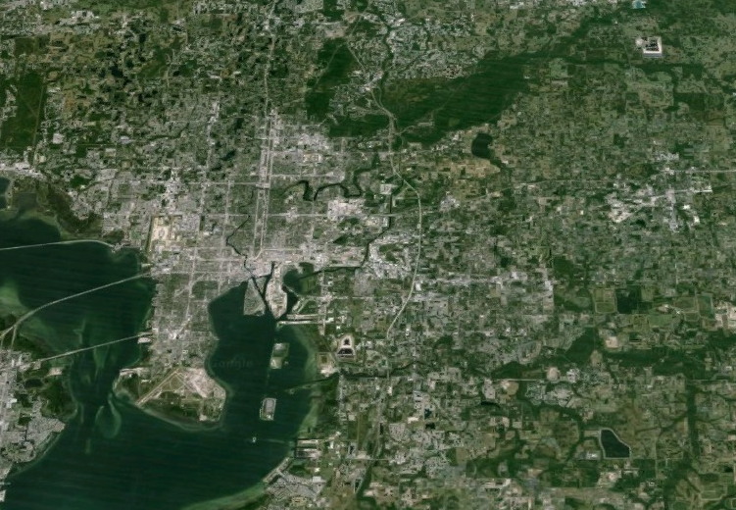

Slide 4
WE ARE AS BIG AS RHODE ISLAND

Slide 5


Slide 6
1.3 MILLION PEOPLE LIVE HERE

Slide 7
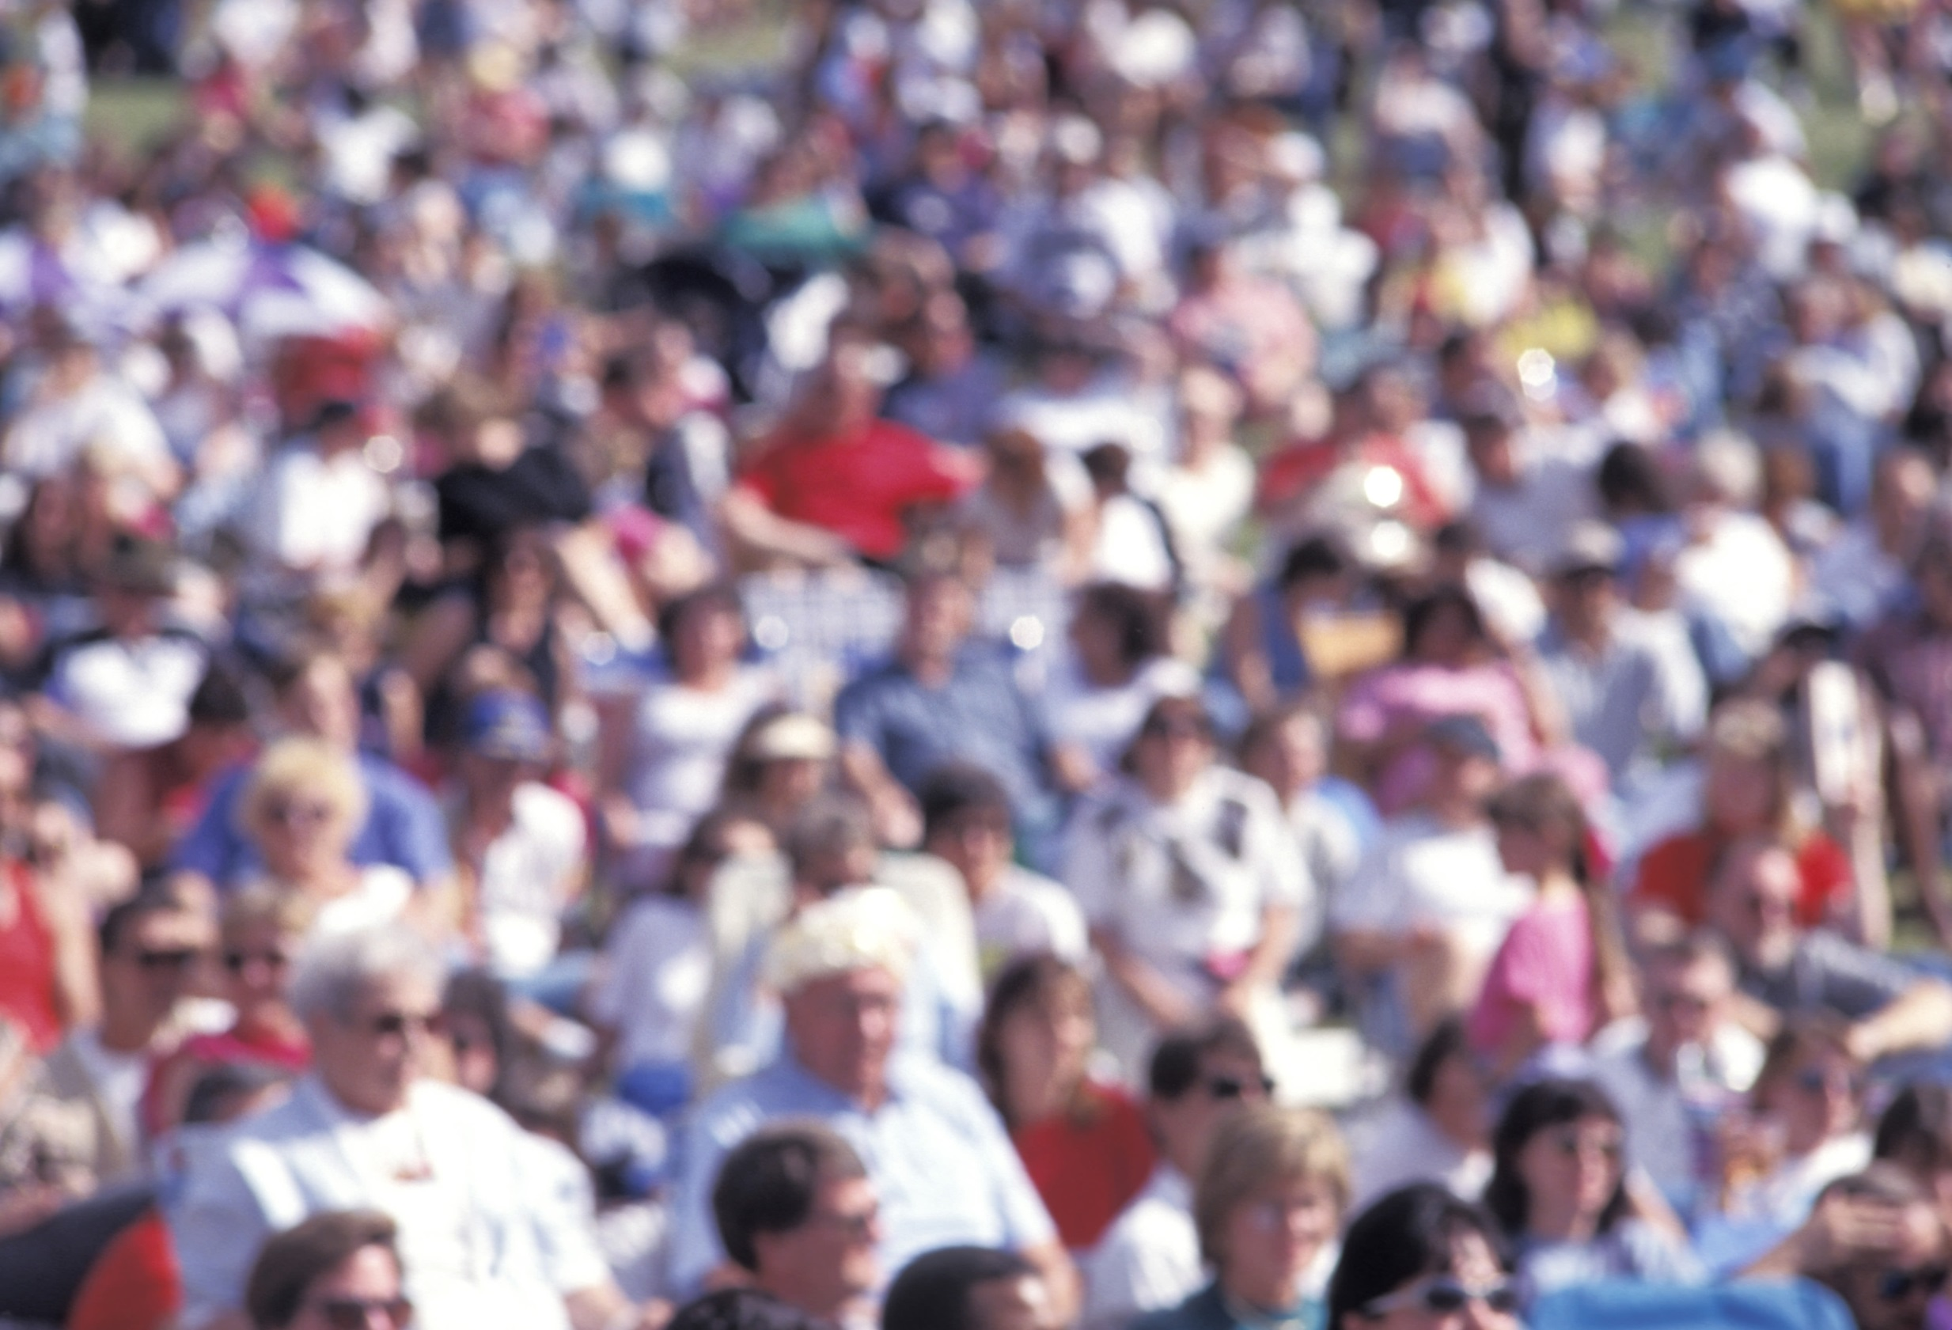

Slide 8
THAT’S A POPULATION LARGER THAN EIGHT U.S. STATES AND D.C.

Slide 9
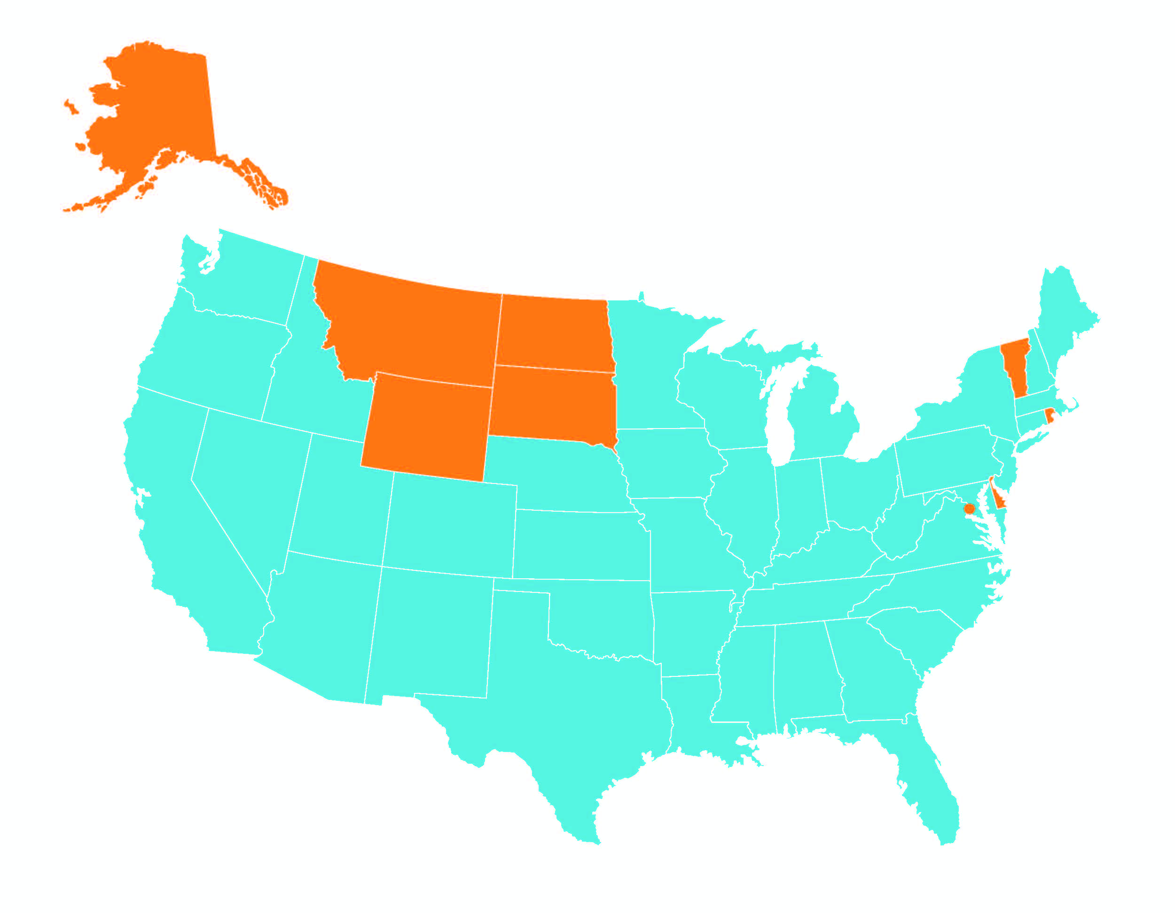

Slide 10
WE WILL HAVE 1.8 MILLION PEOPLE LIVING HERE BY 2040

Slide 11
THAT IS EQUIVALENT TO ALMOST 2 MORE TAMPAs

Slide 12
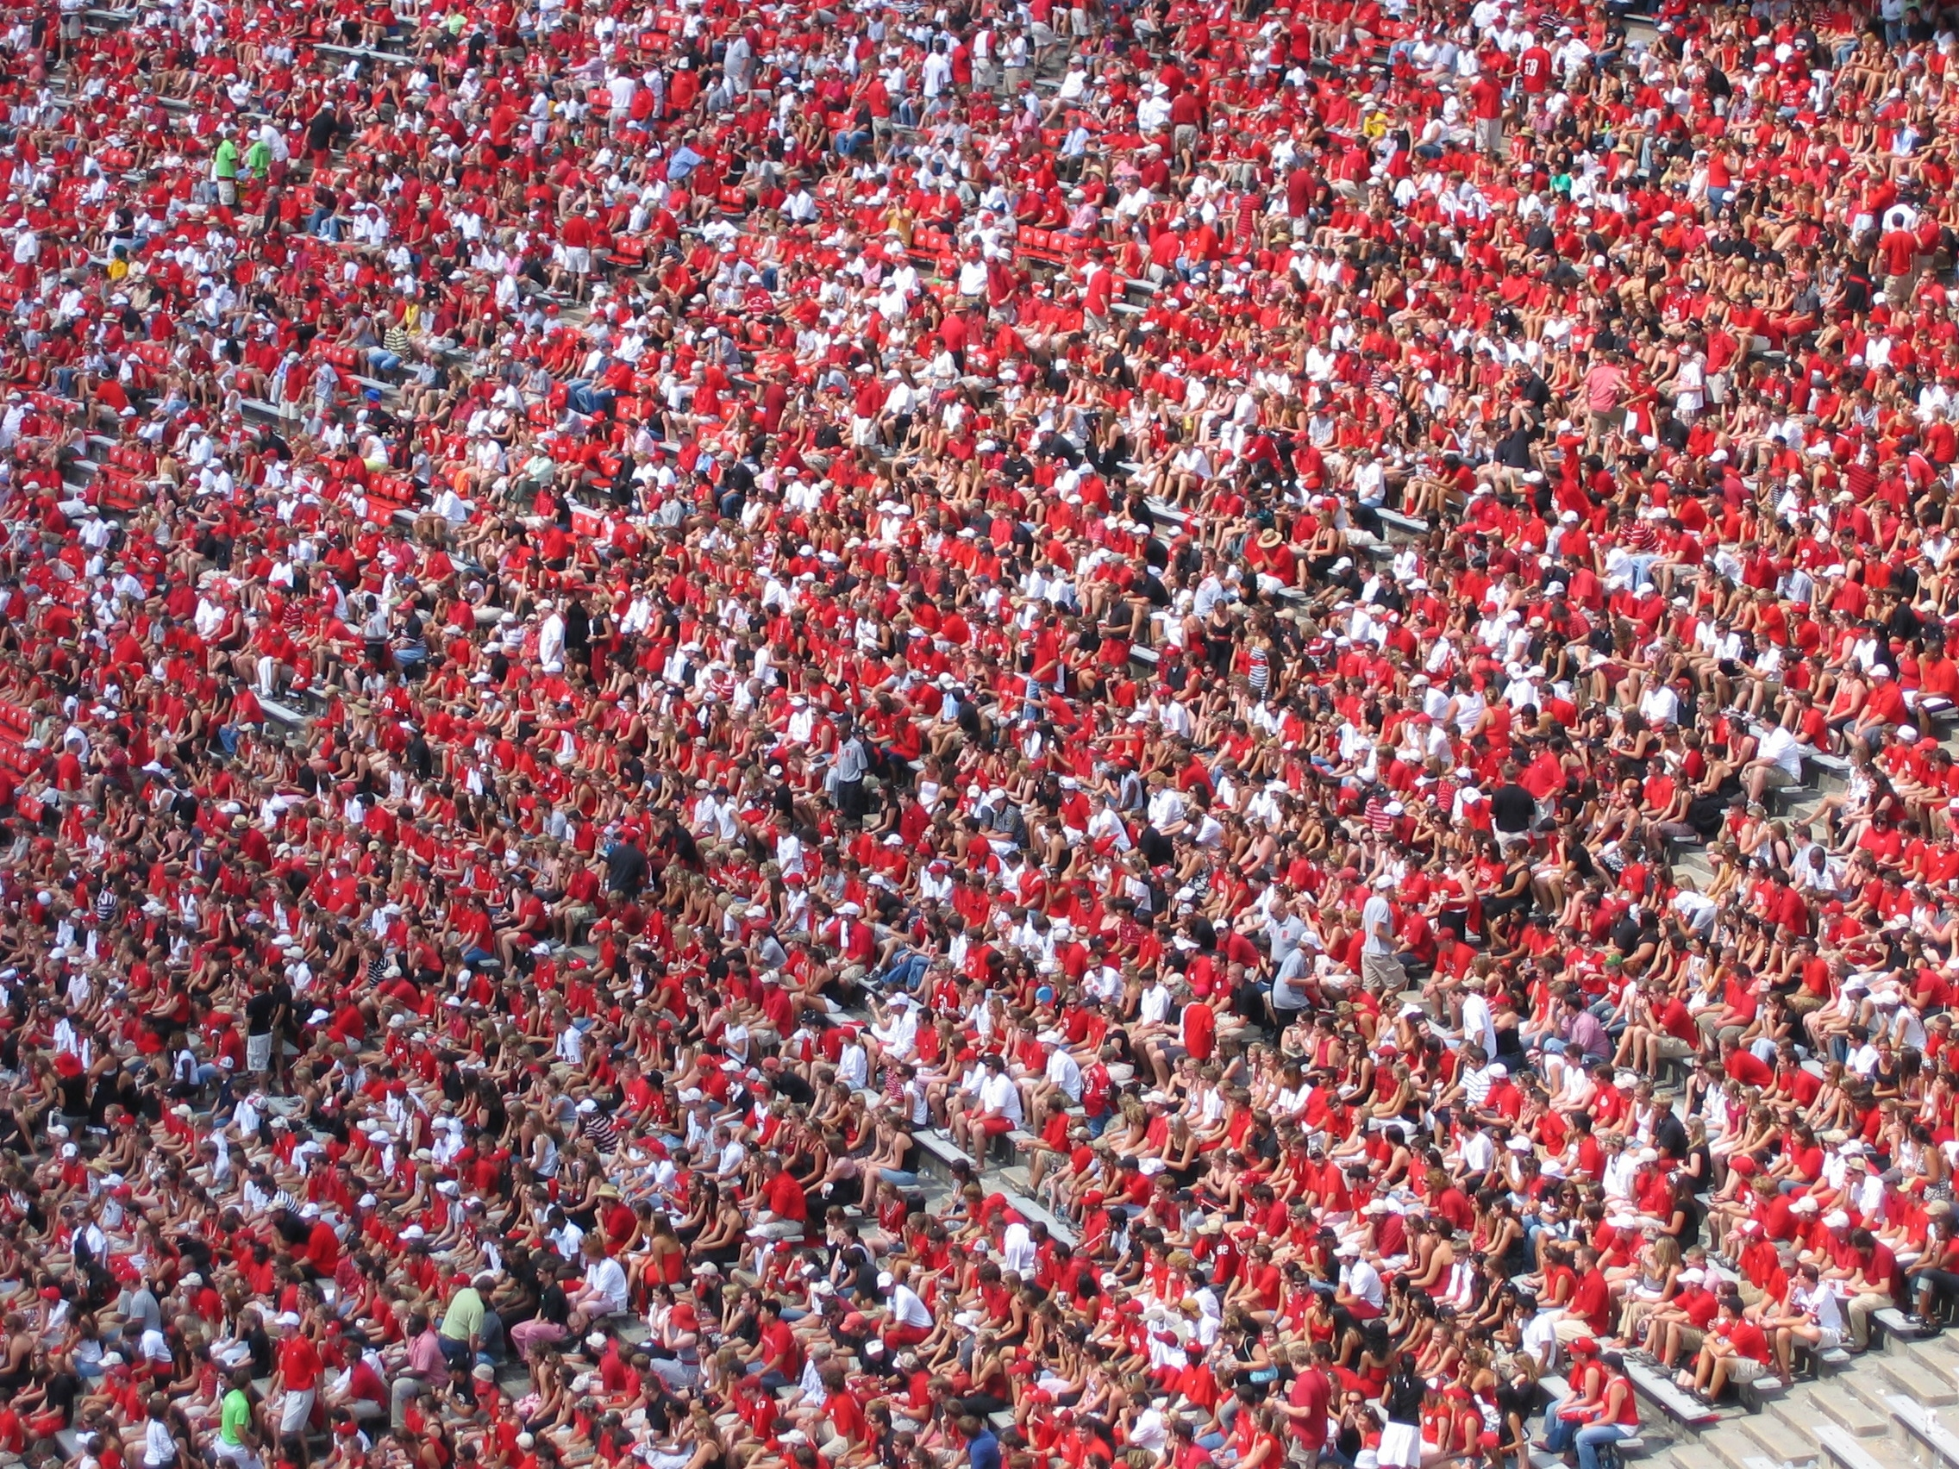

Slide 13
HILLSBOROUGH COUNTY HAS MORE THAN 12,000 MILES OF ROADS

Slide 14
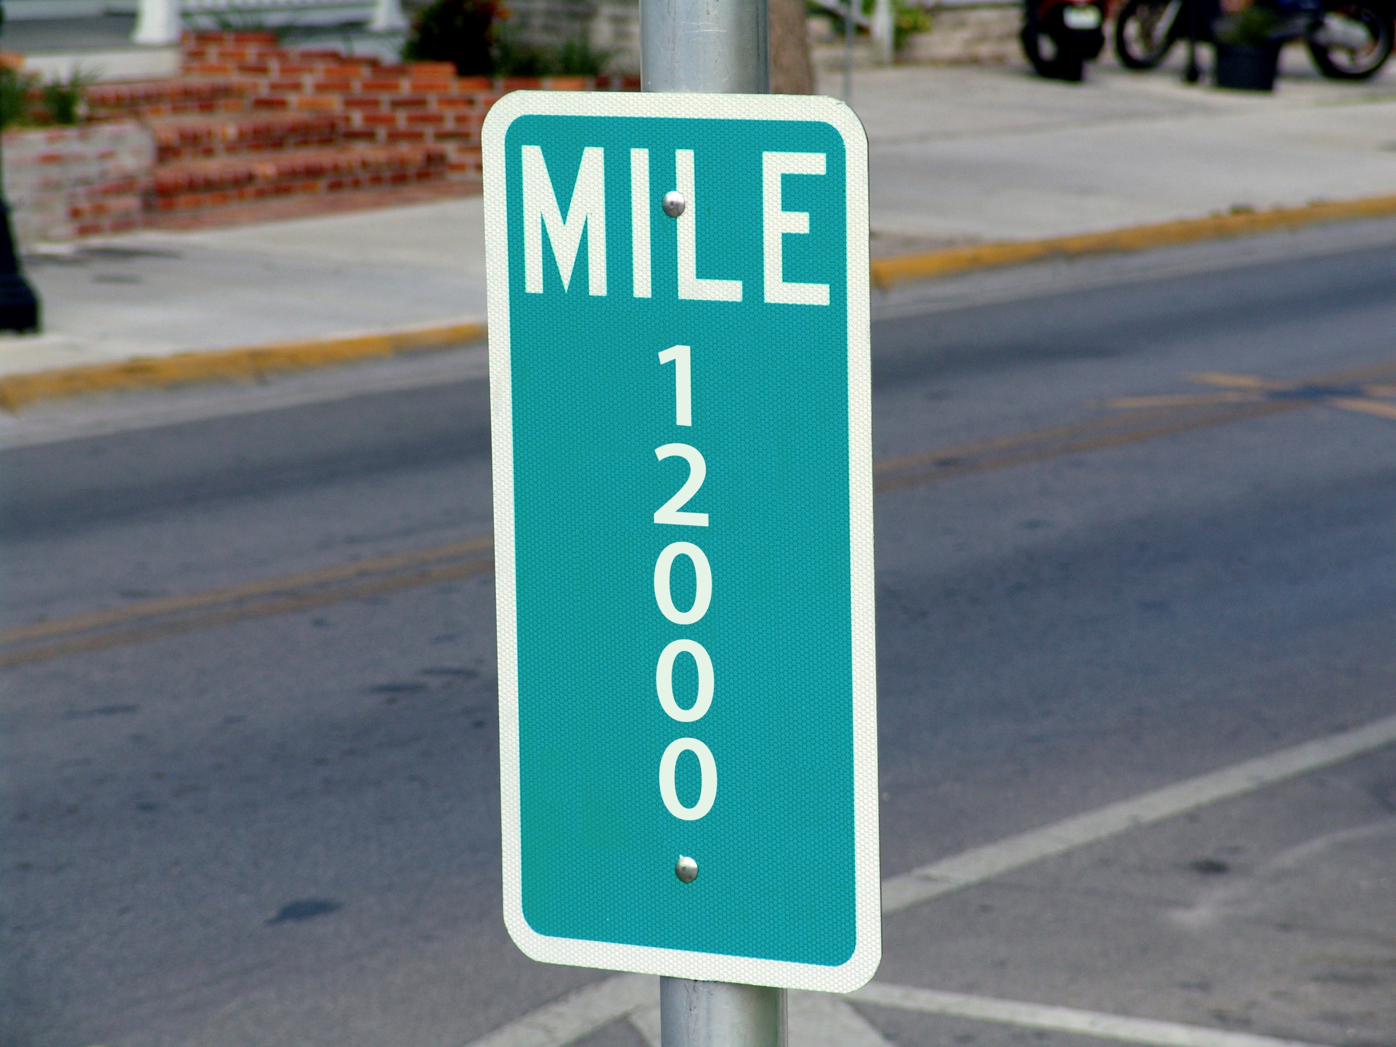

Slide 15
THAT’S A GIANT LOOP AROUND AMERICA – FROM Miami to Boston to Chicago to Anchorage to Seattle to San Diego to New Orleans to Tampa

Slide 16
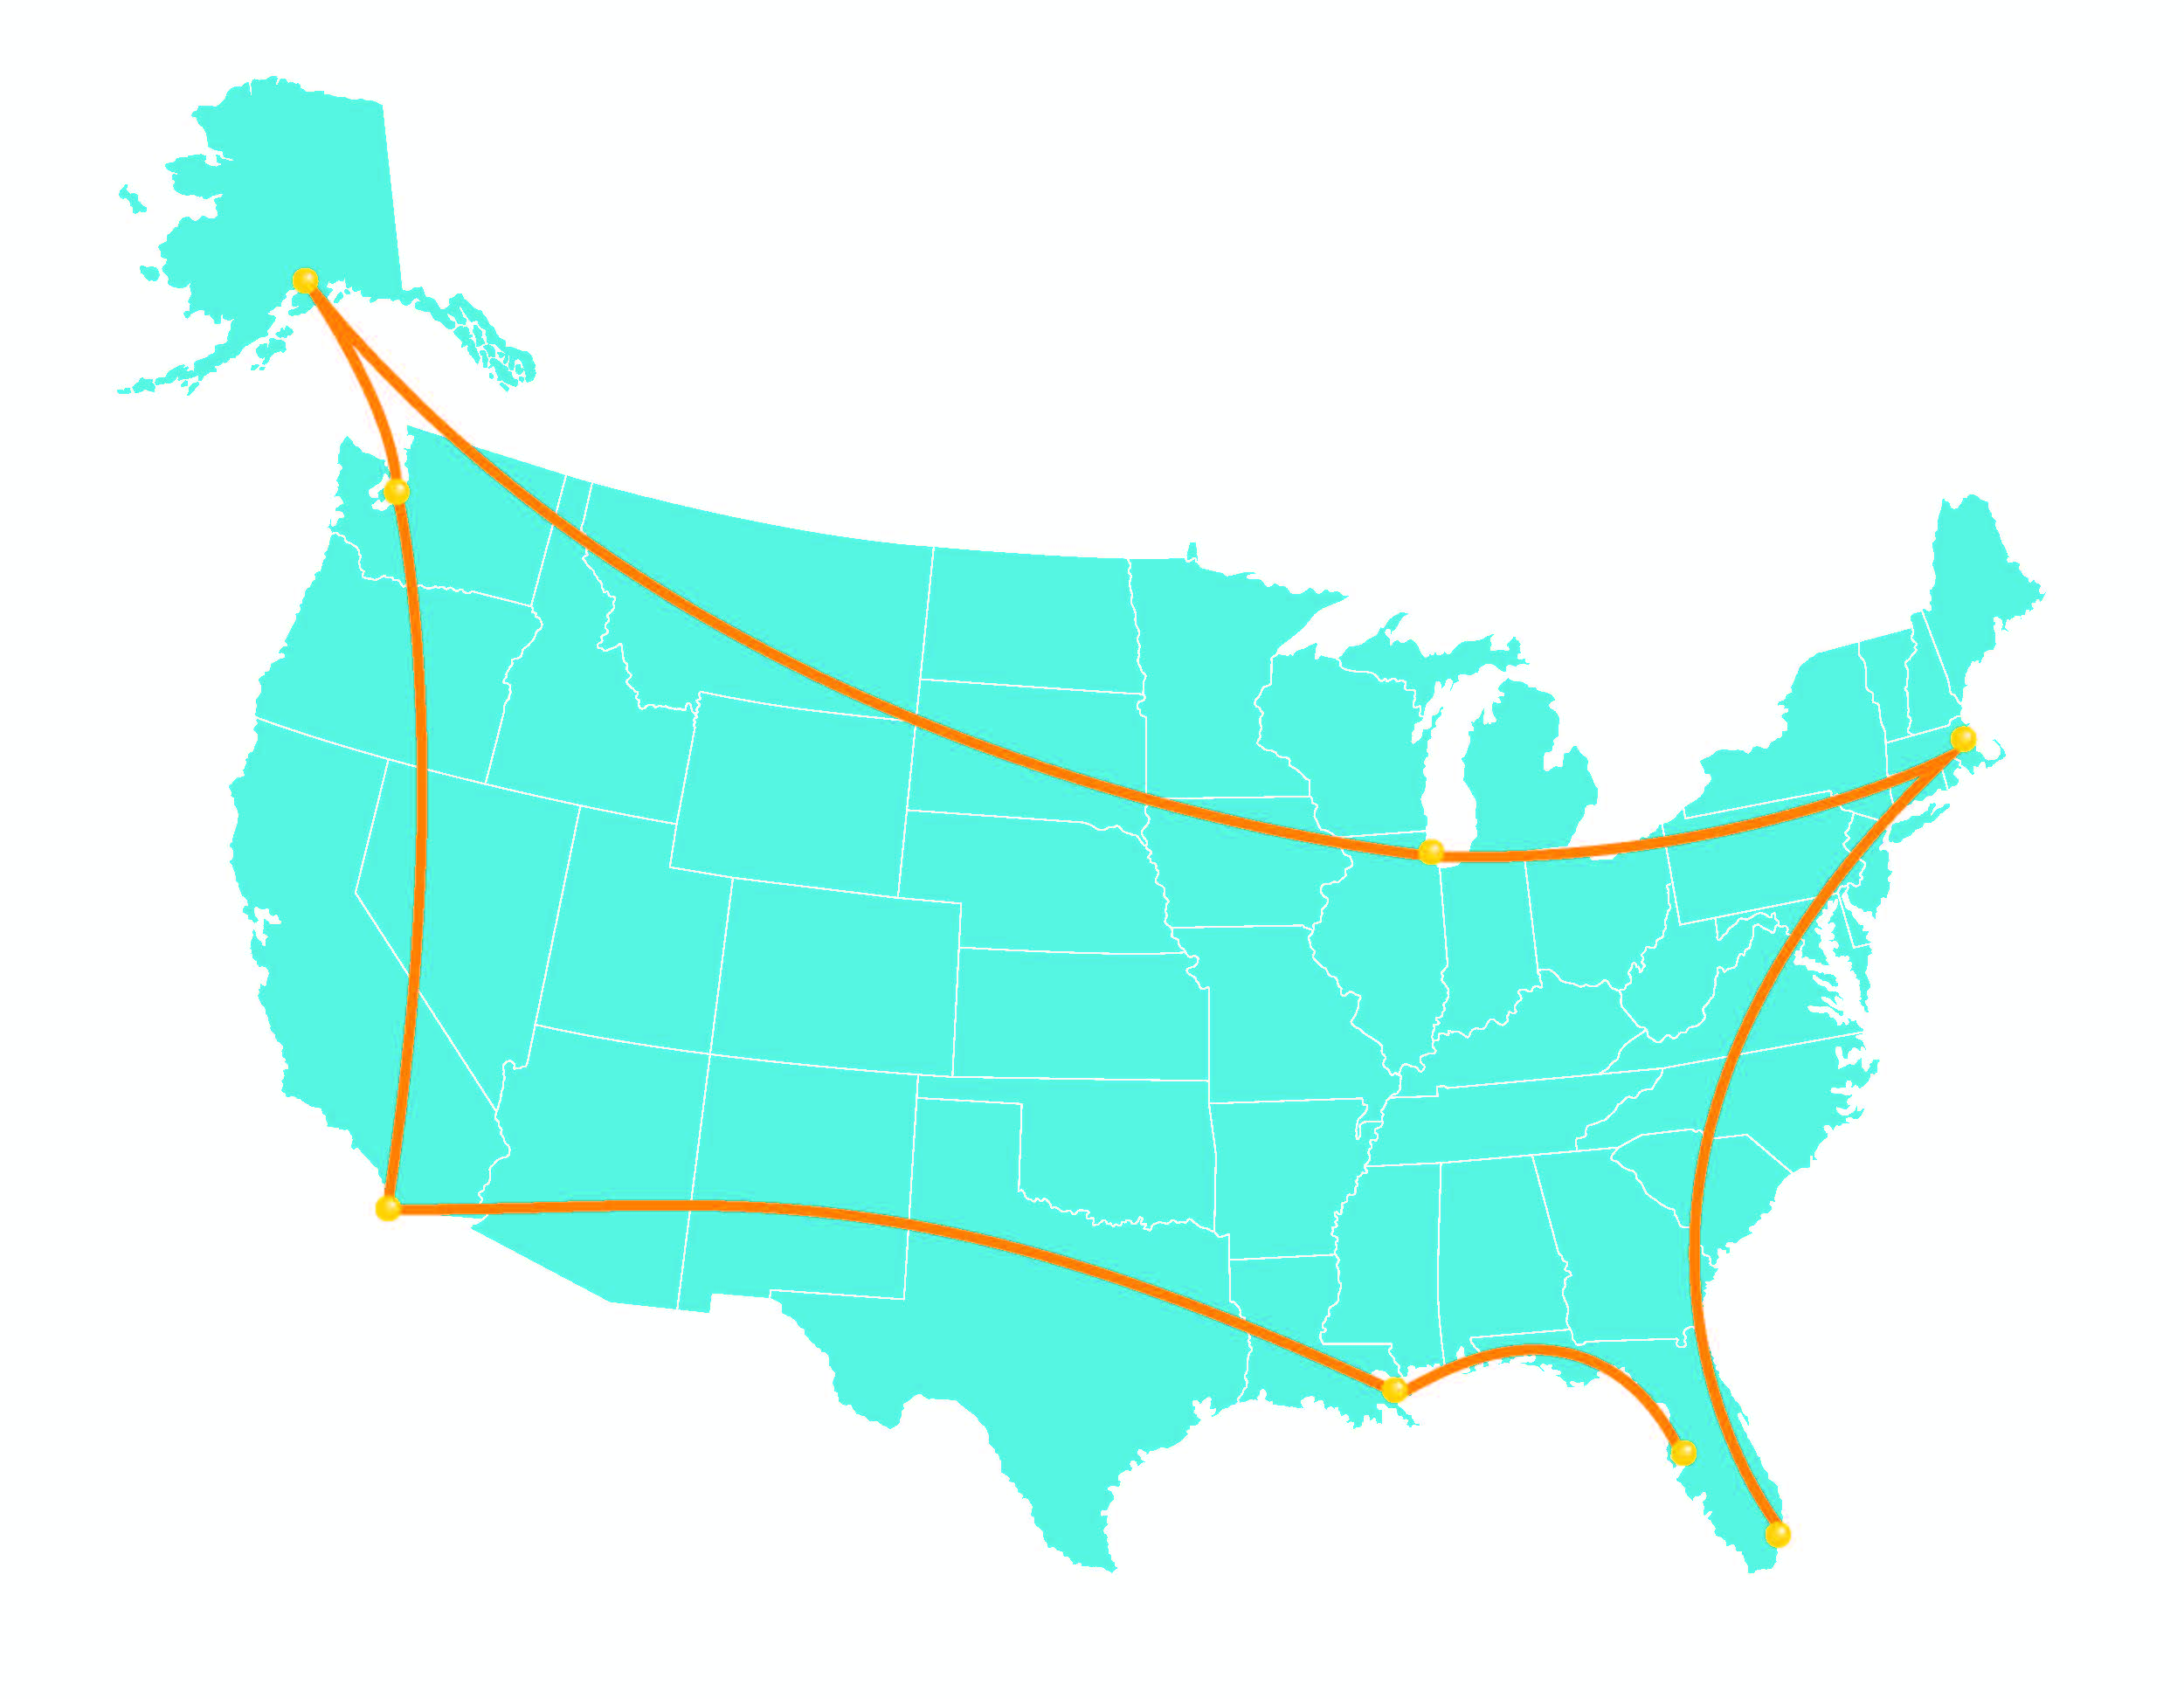

Slide 17
OUR COMMUNITY HAS INVESTED $1.3B IN TRANSPORTATION OVER THE LAST 20 YEARS

Slide 18
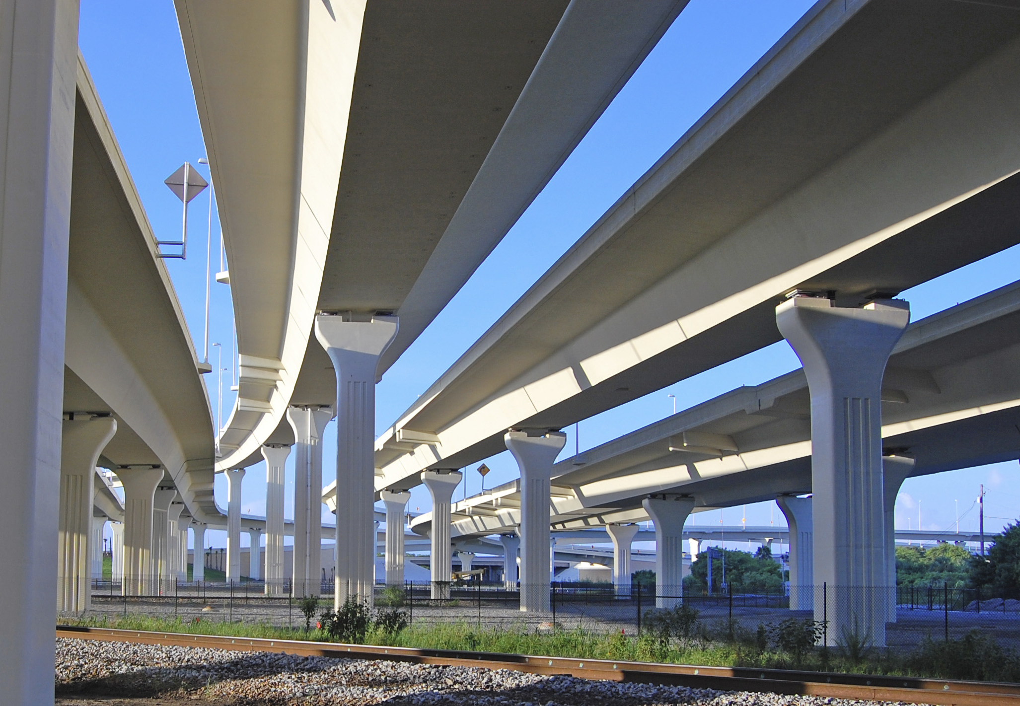

Slide 19
THE COUNTY USED OVER 50% OF ITS CIT DOLLARS ON TRANSPORTATION

Slide 20
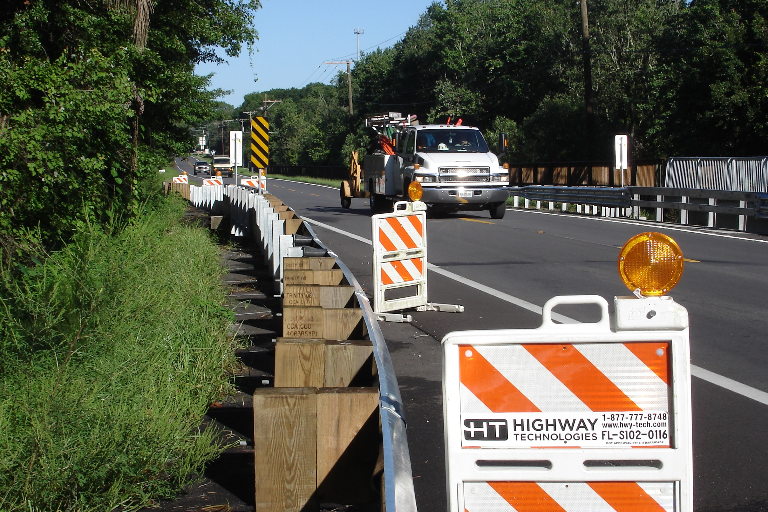

Slide 21
TAMPA INVESTED 20% OF ITS CIT FUNDS IN TRANSPORTATION

Slide 22
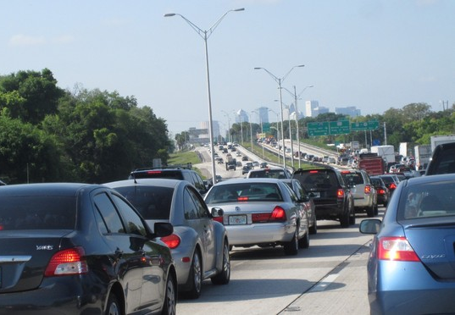

Slide 23
OUR TRANSPORTATION INFRASTRUCTURE IS BECOMING INCREASINGLY DIFFICULT TO MAINTAIN

Slide 24
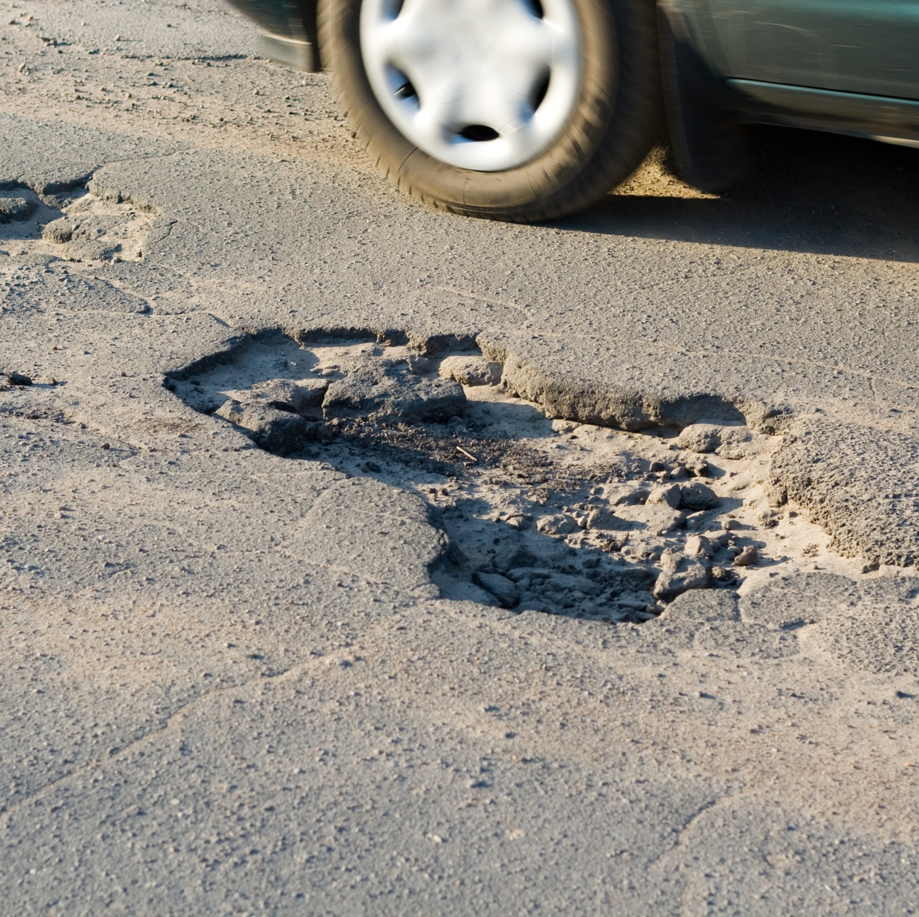

Slide 25
WE ARE FACING $750M IN MAINTENANCE NEEDS

Slide 26


Slide 27
OUR ROADS & INTERSECTIONS ARE STILL FAILING

Slide 28
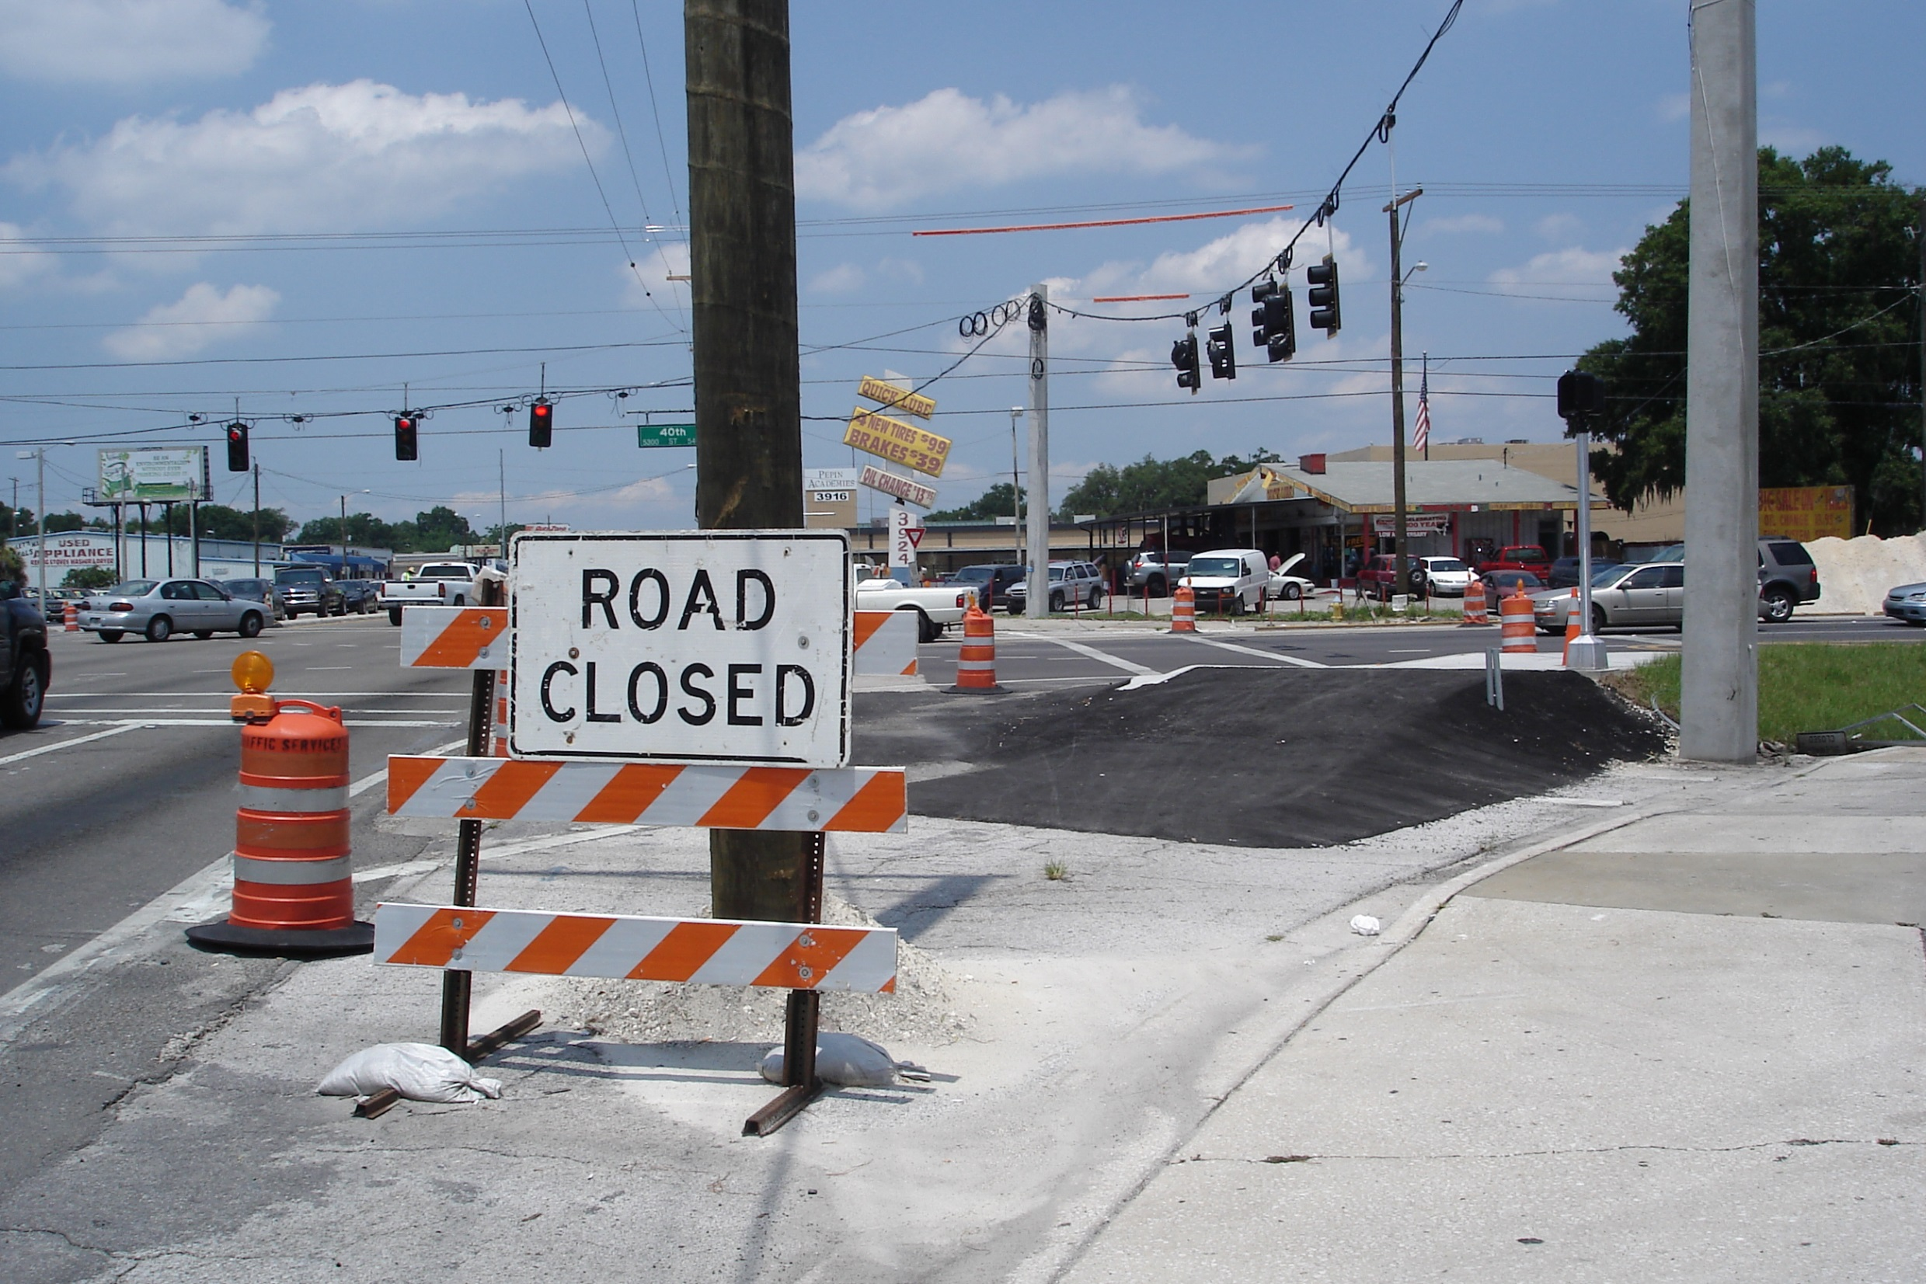

Slide 29
HART IS UNABLE TO EXPAND SERVICES

Slide 30
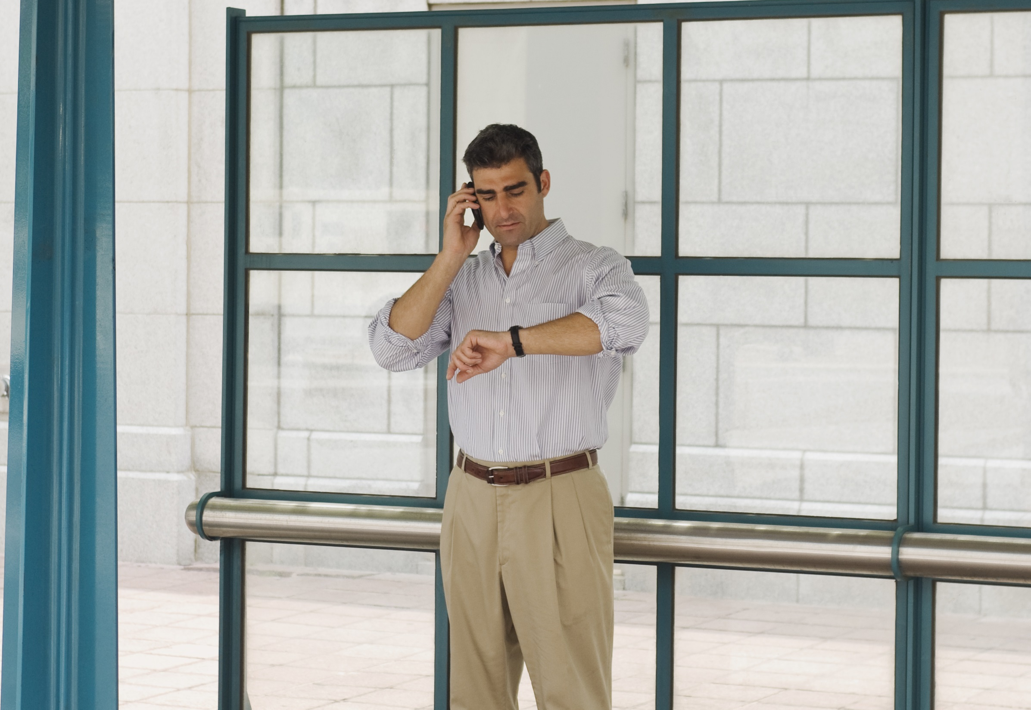

Slide 31
FLORIDA STATE LAW RECENTLY CHANGED & DEVELOPERS DON’T HAVE TO HELP PAY FOR BACKLOG ANYMORE

Slide 32
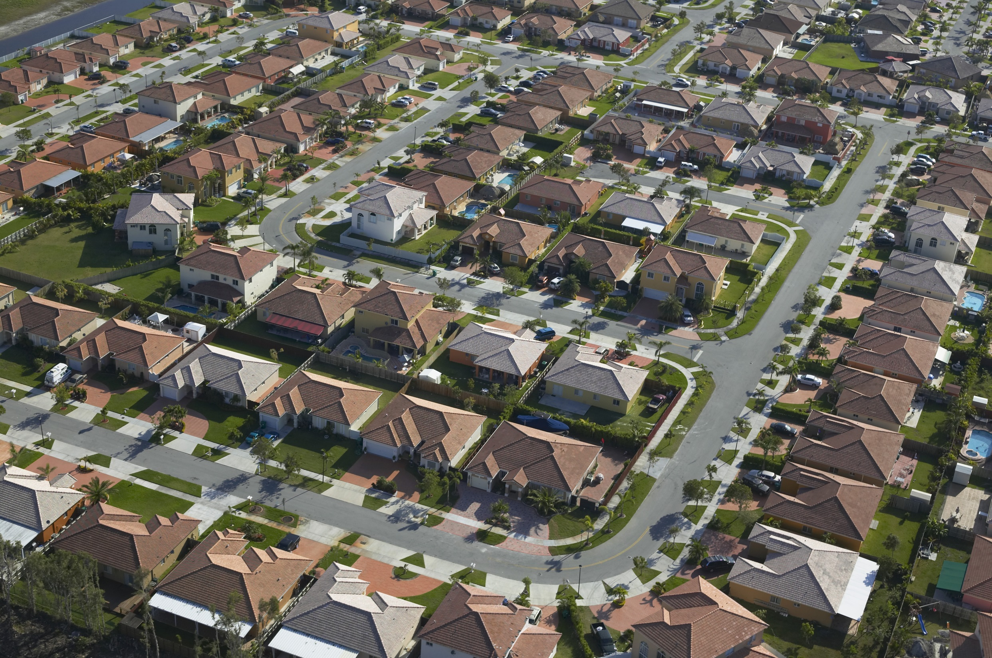

Slide 33
GAS TAXES ARE A SLOW GROWING SOURCE OF REVENUE & THEY HAVEN’T KEPT PACE WITH COSTS

Slide 34
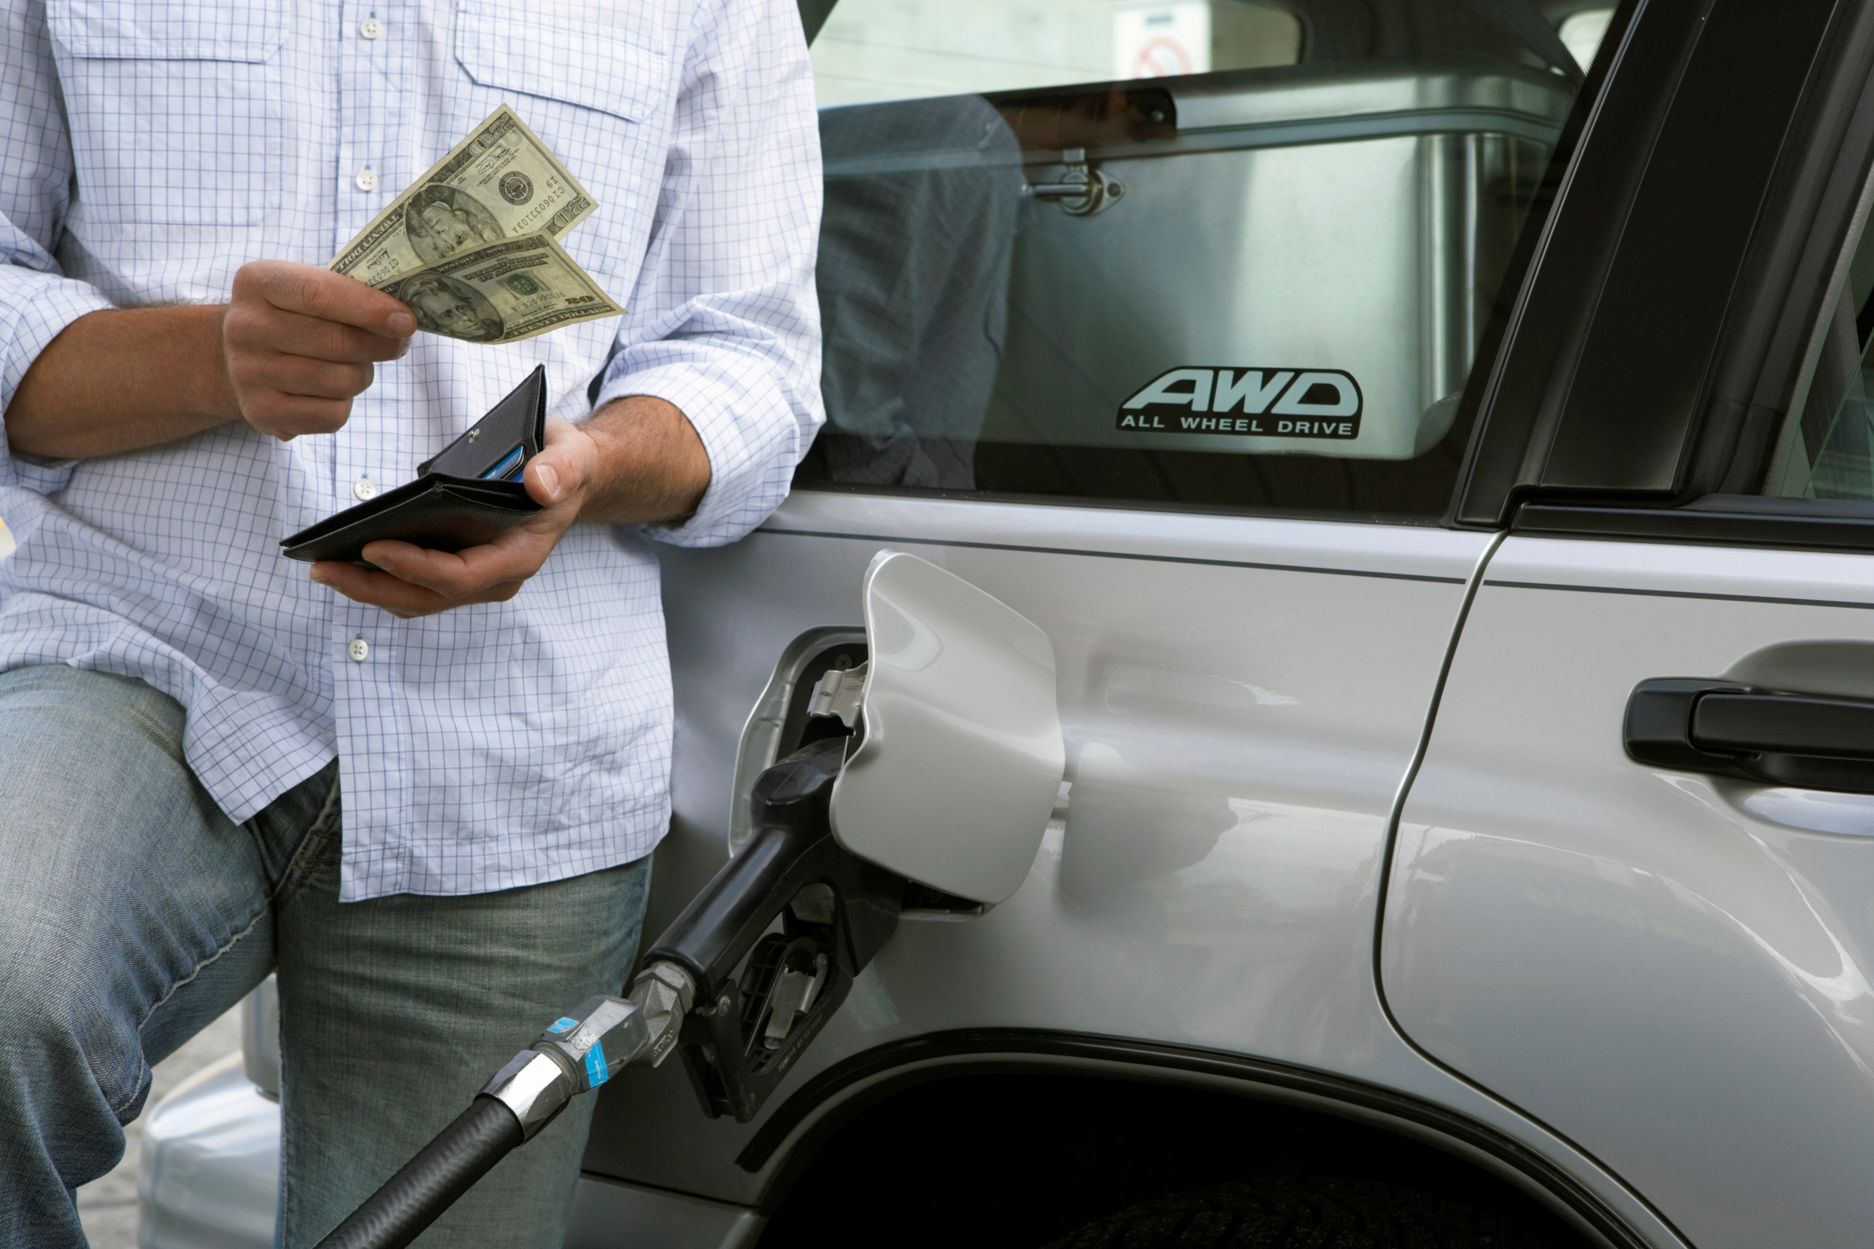

Slide 35
WE ARE FACING A DECLINE IN OUR QUALITY OF LIFE

Slide 36
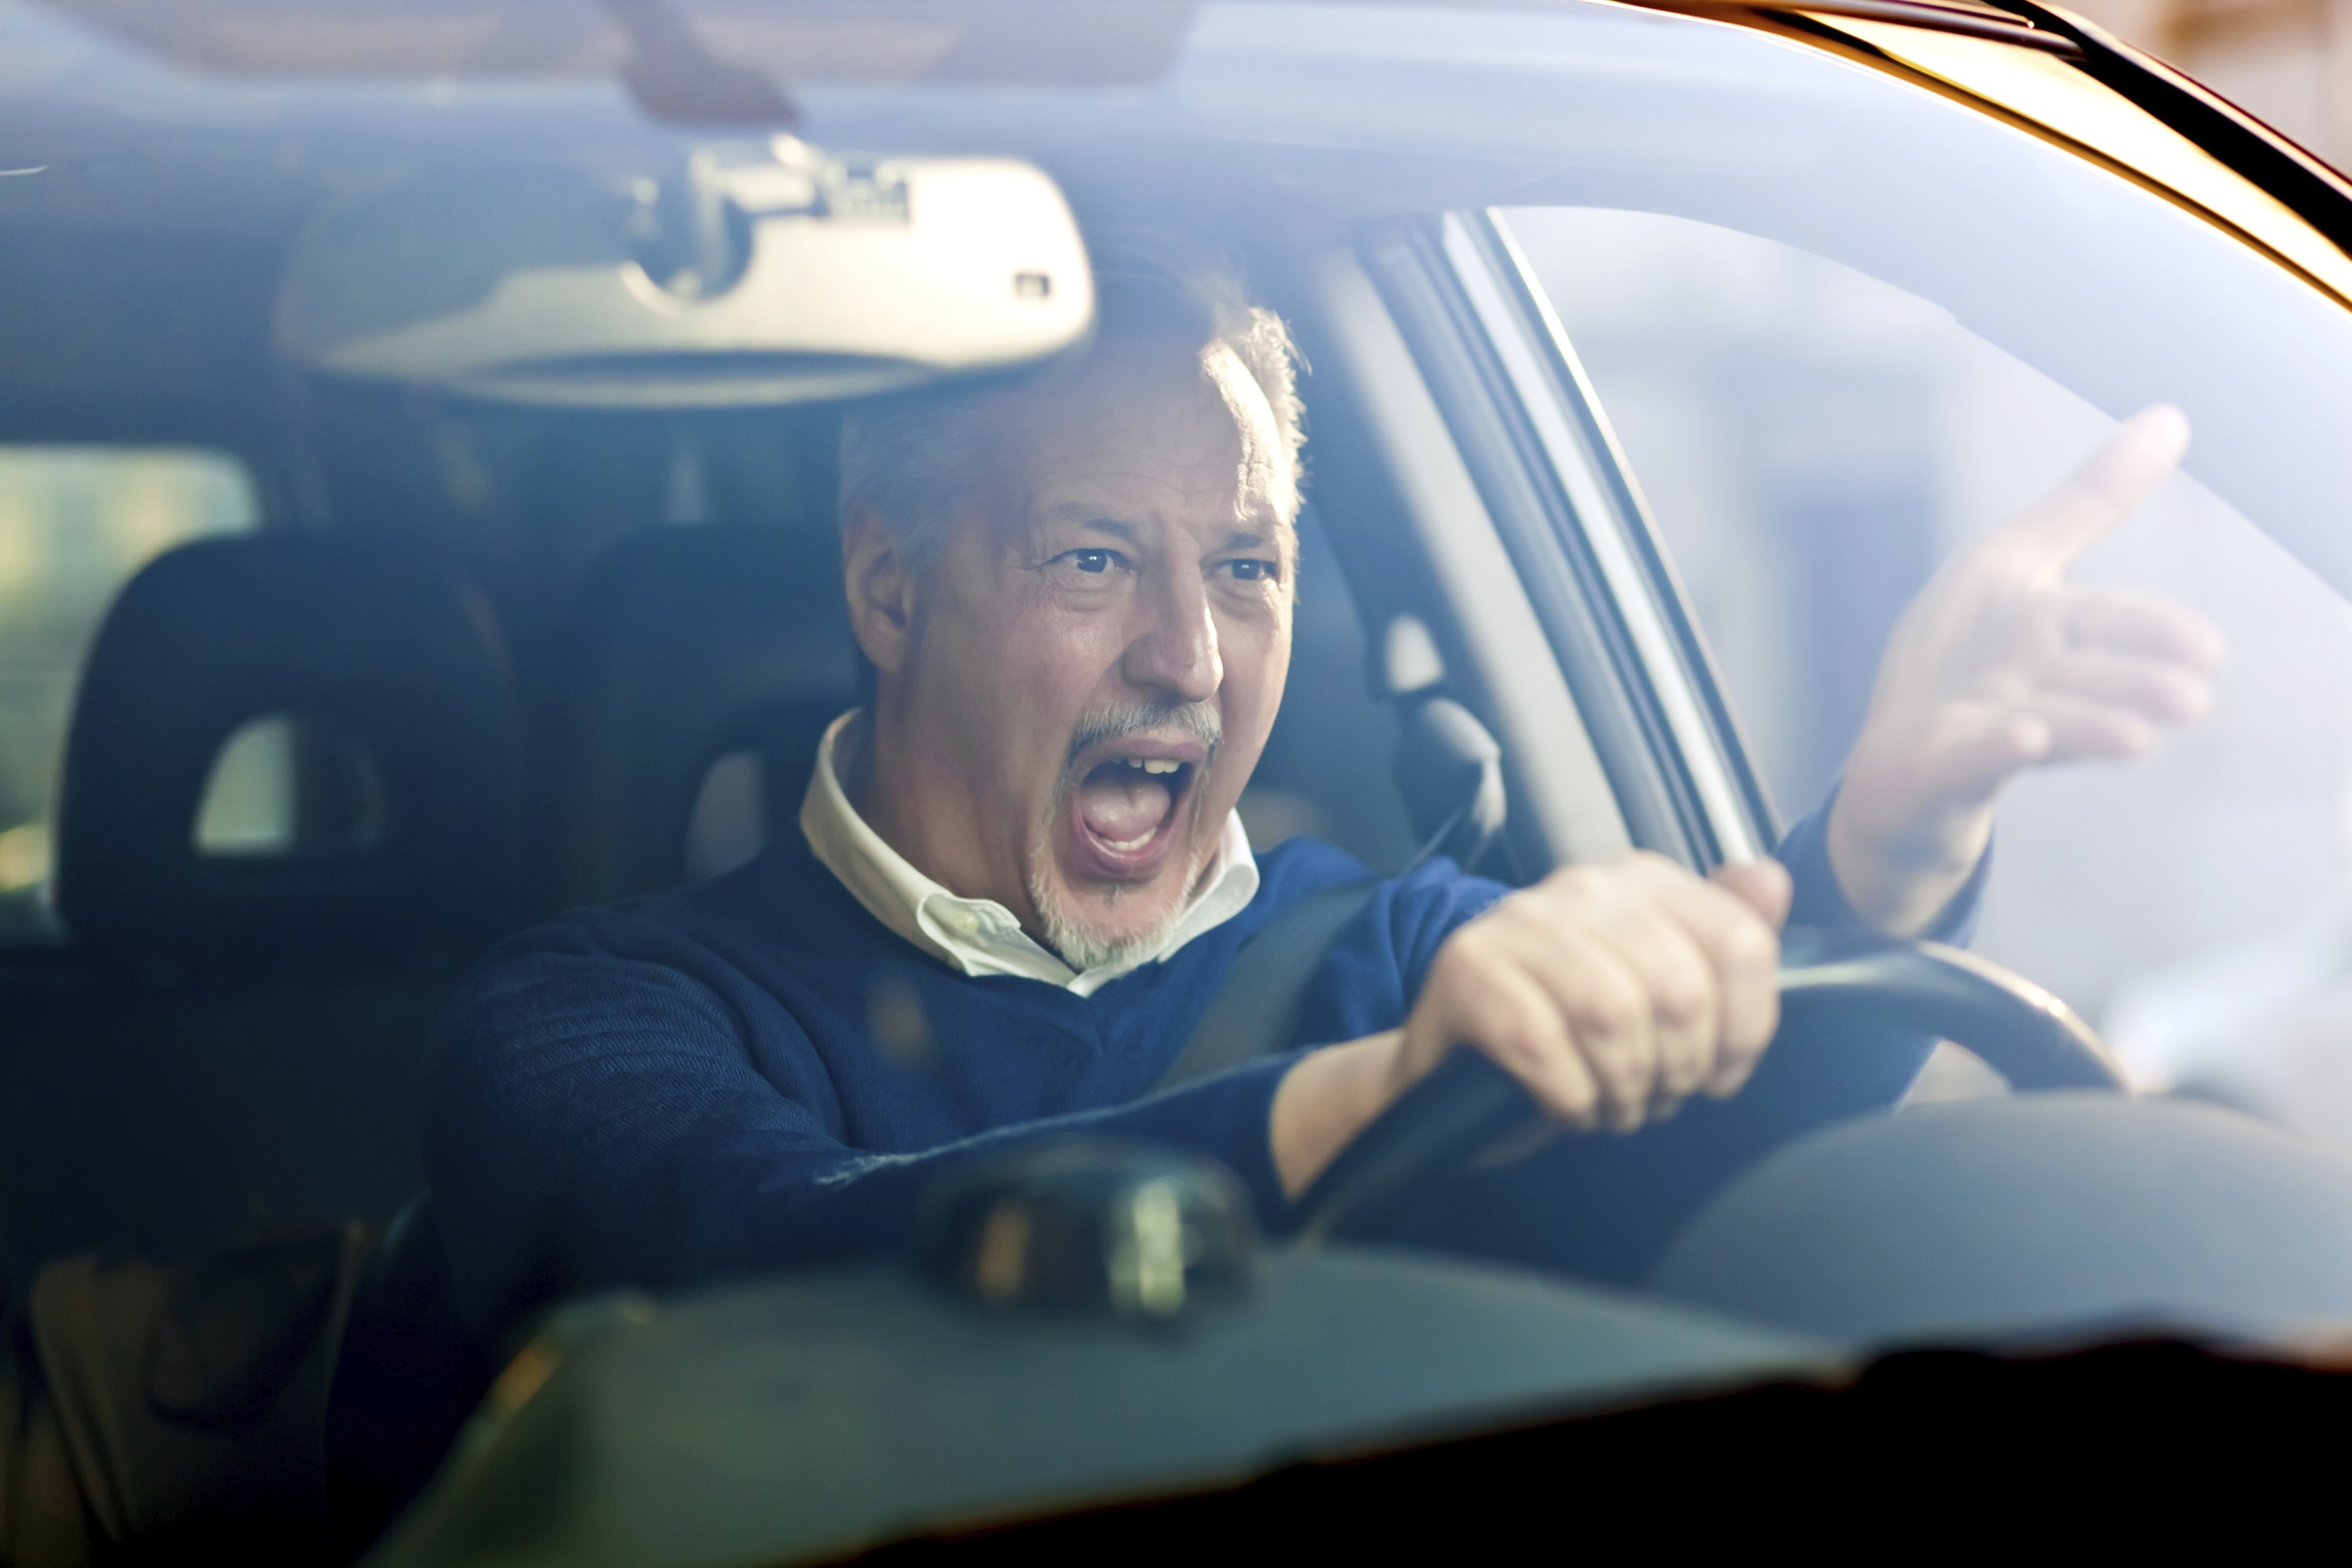

Slide 37
THE LONGER WE WAIT, THE WORSE IT GETS

Slide 38
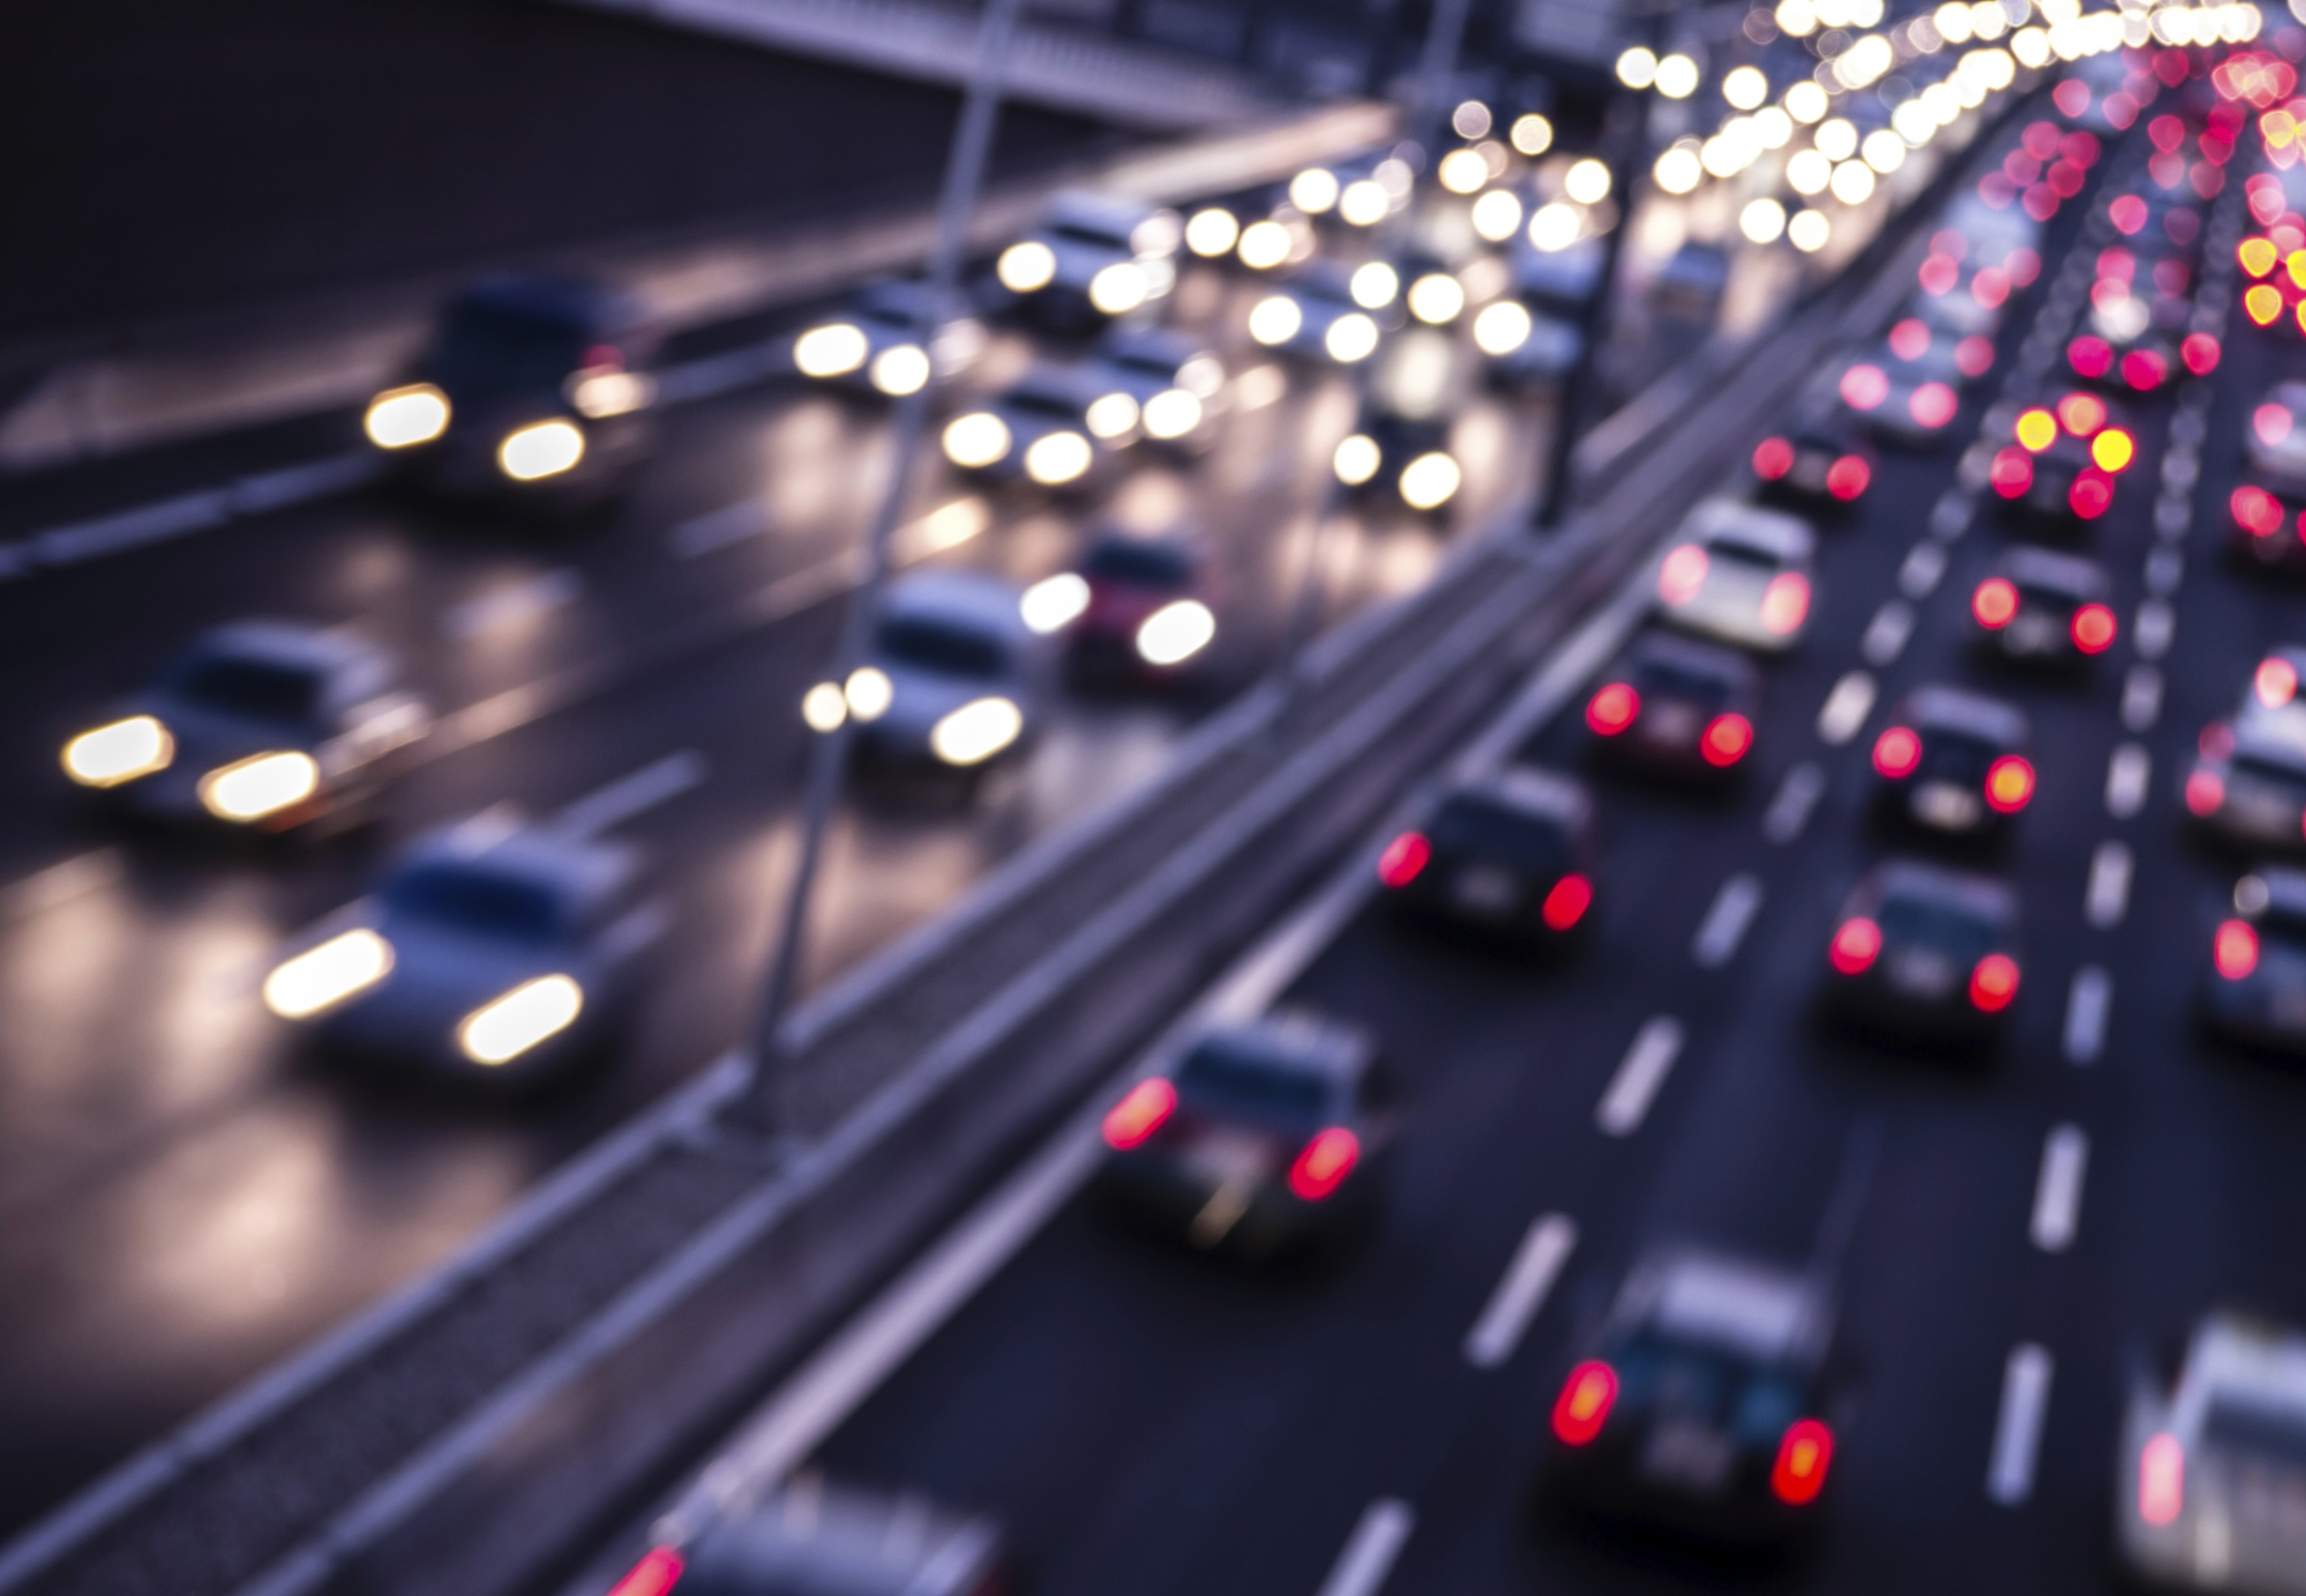

Slide 39
THE WORSE IT GETS, THE MORE IT COSTS.

Slide 40
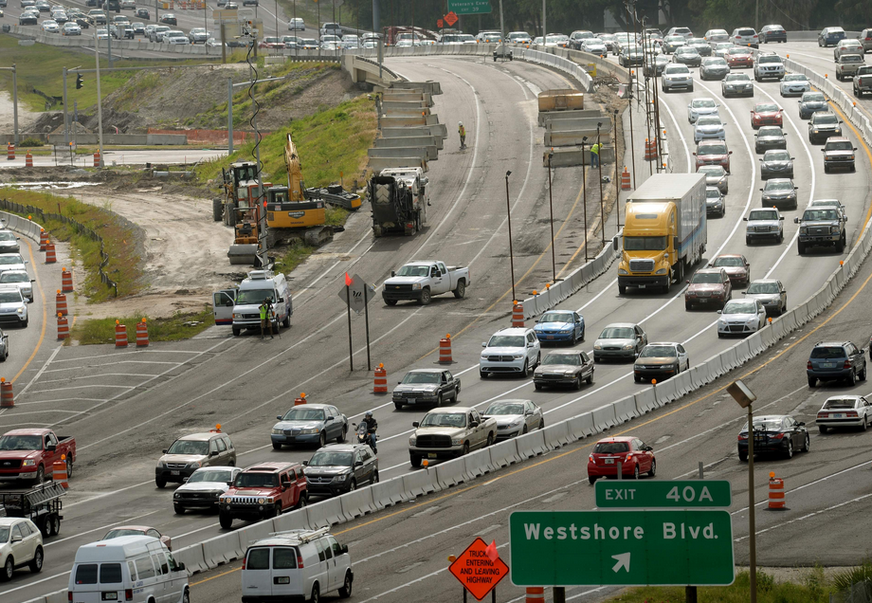

Slide 41
THE TIME HAS COME TO ADDRESS OUR TRANSPORTATION CRISIS

Slide 42
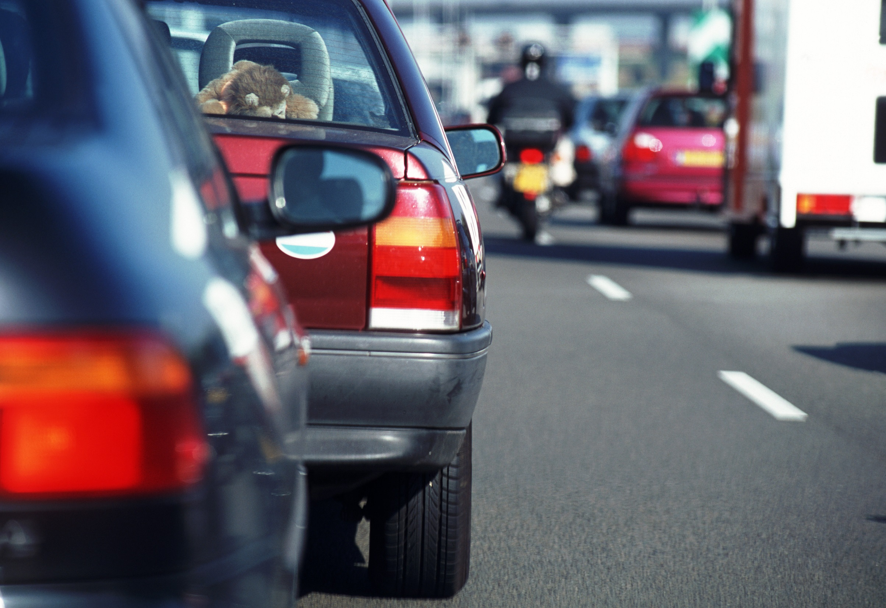

Slide 43
EMERGING CONSENSUS ON COMMUNITY-WIDE PRIORITIES

Slide 44


Slide 45
COMMUNITY-WIDE PRIORITY #1 MAINTENANCE AND RESURFACING

Slide 46
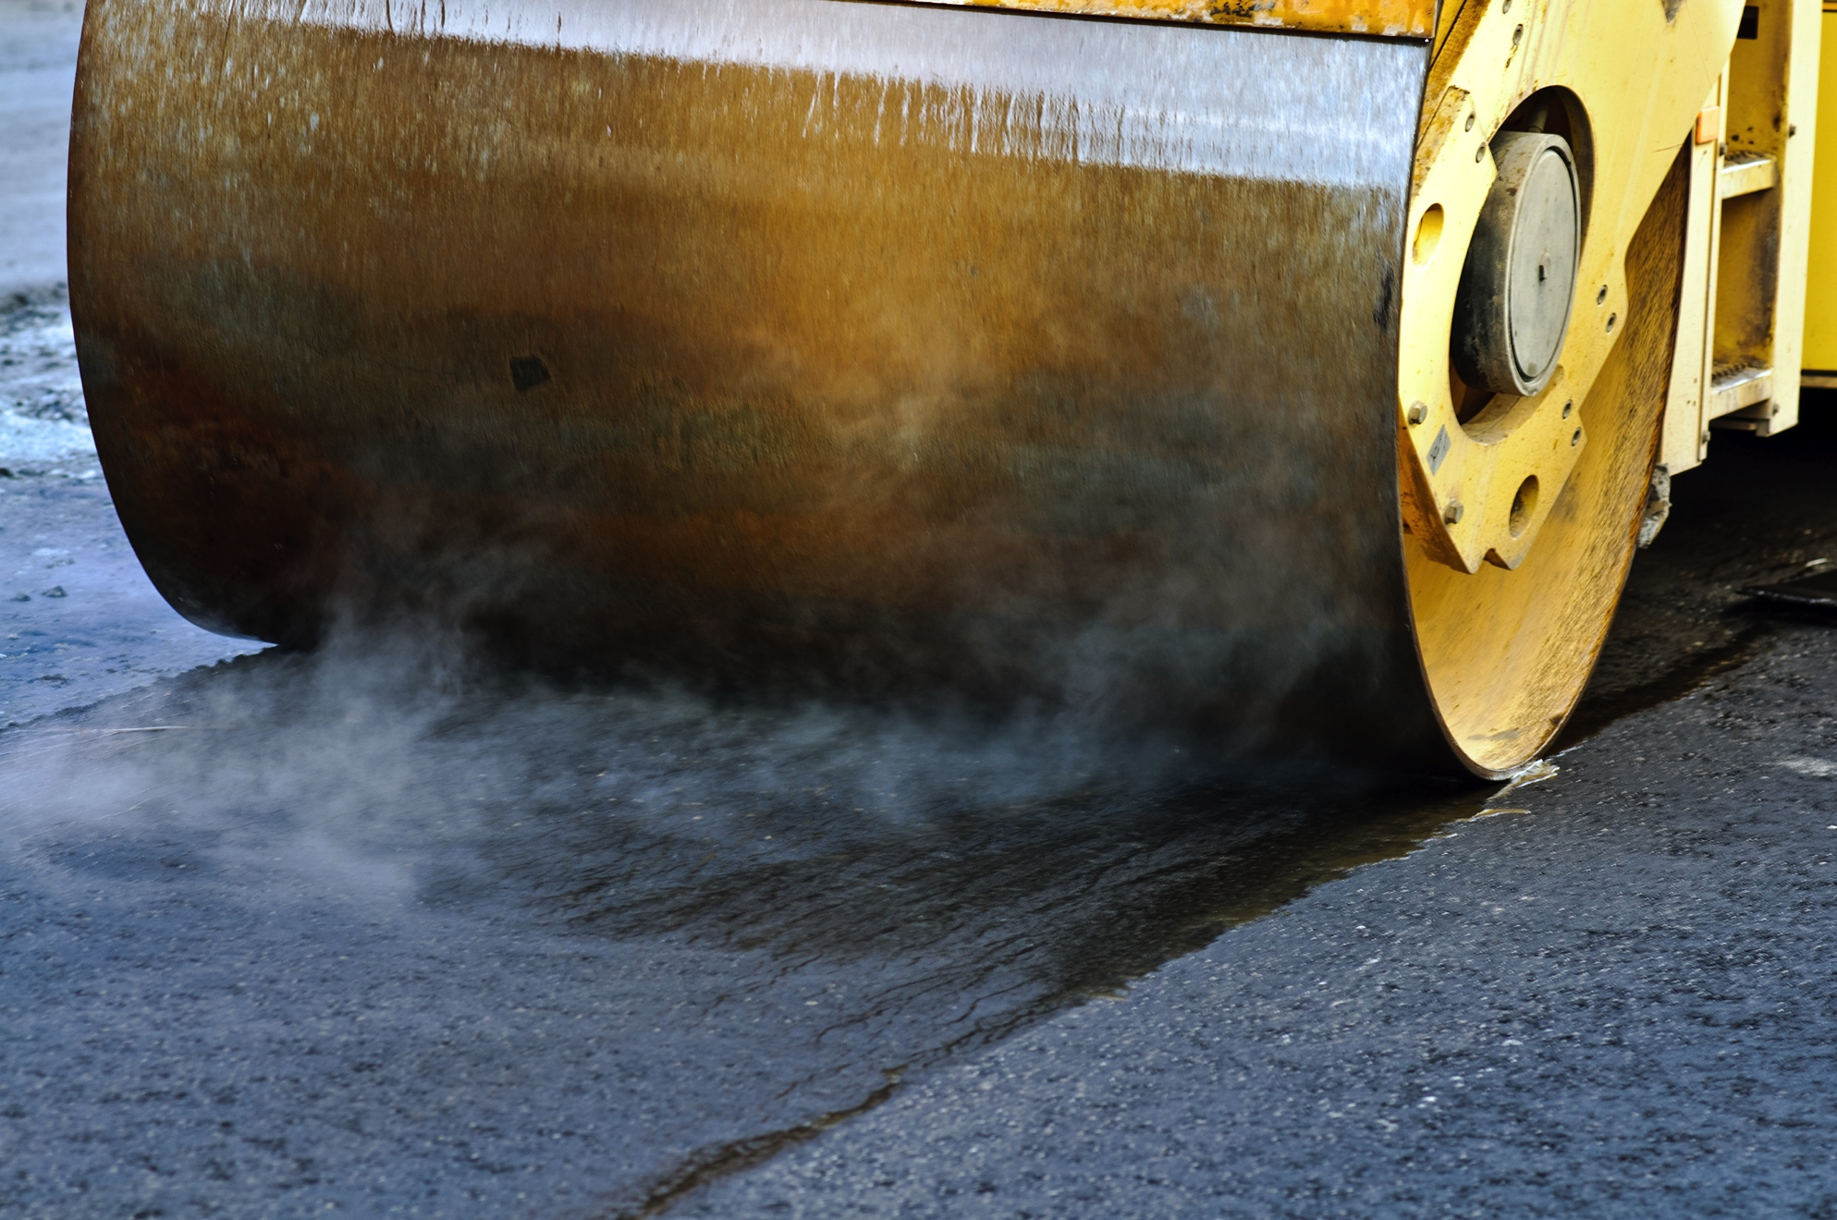

Slide 47
COMMUNITY-WIDE PRIORITY #2 - #3 BOTH ROADS & TRANSIT

Slide 48
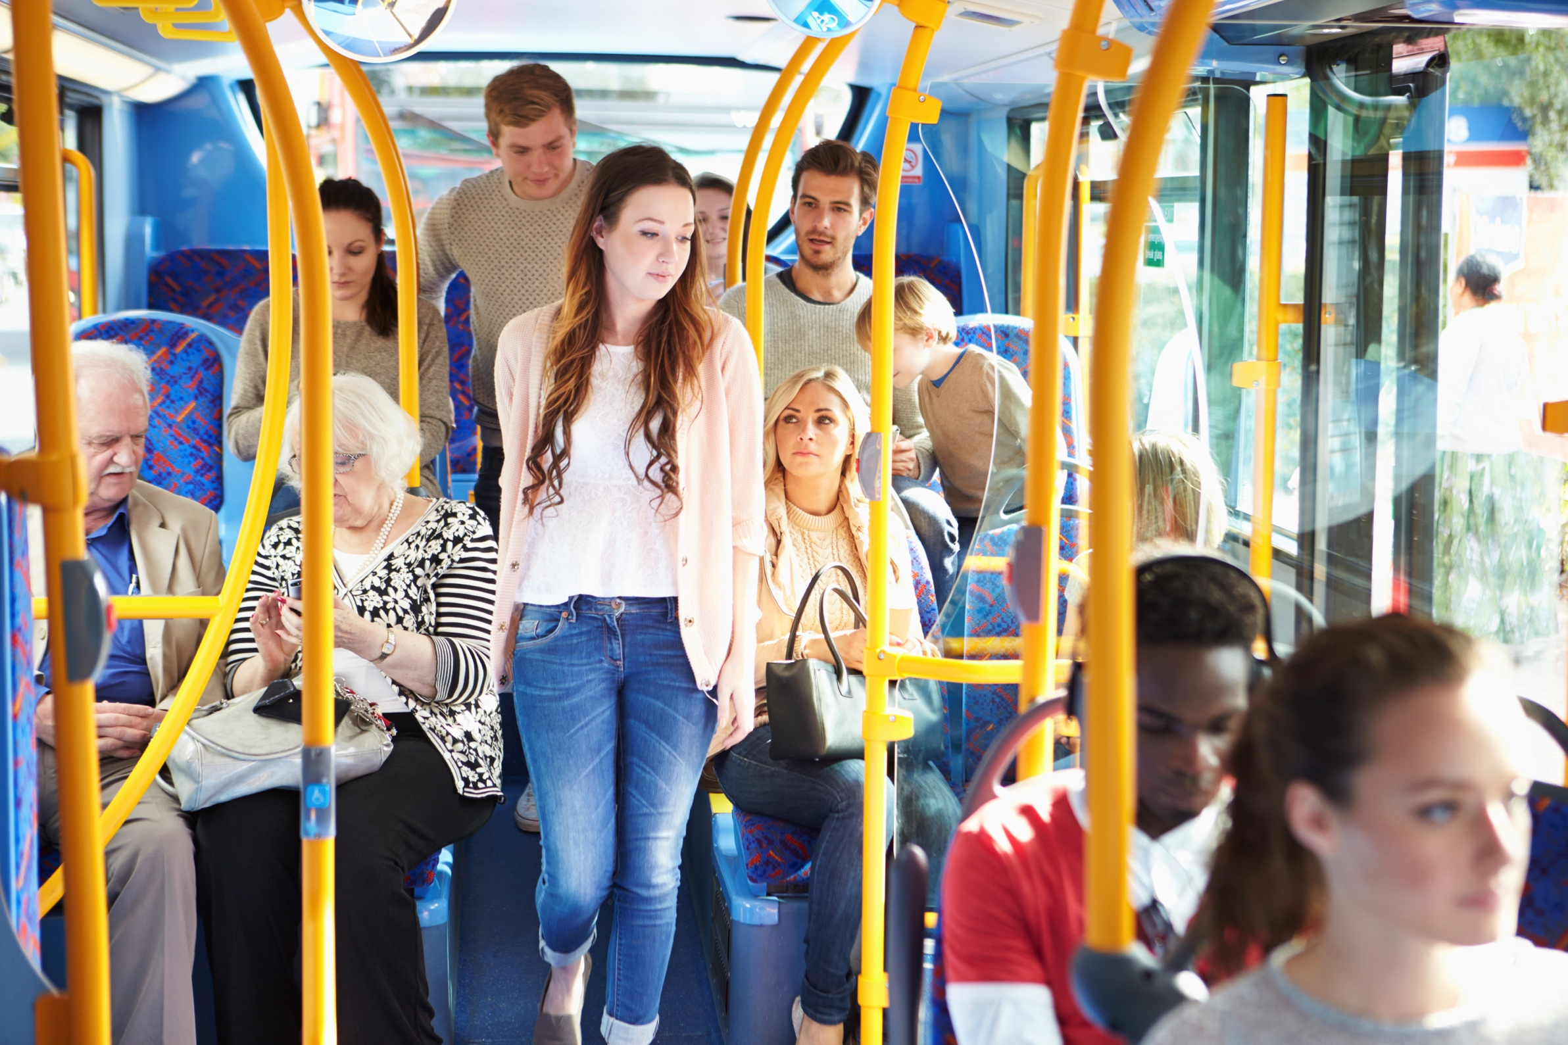

Slide 49
COMMUNITY WIDE PRIORITY #4 WALK / BIKE SAFETY
Notes:
http://www.thinkstockphotos.com/image/stock-photo-woman-waits-for-bicycle-traffic-to-pass/153382225/popup?sq=biking%20in%20traffic/f=CPHX/s=DynamicRank

Slide 50
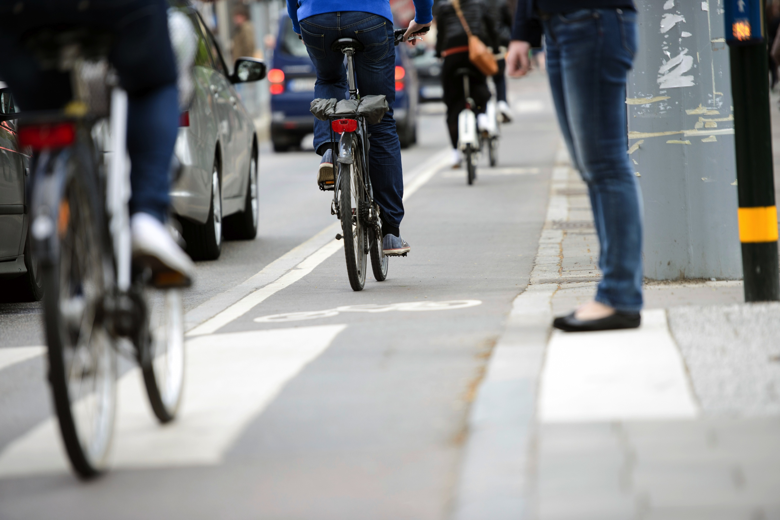

Slide 51
WE CAN DO SOMETHING ABOUT THIS

Slide 52
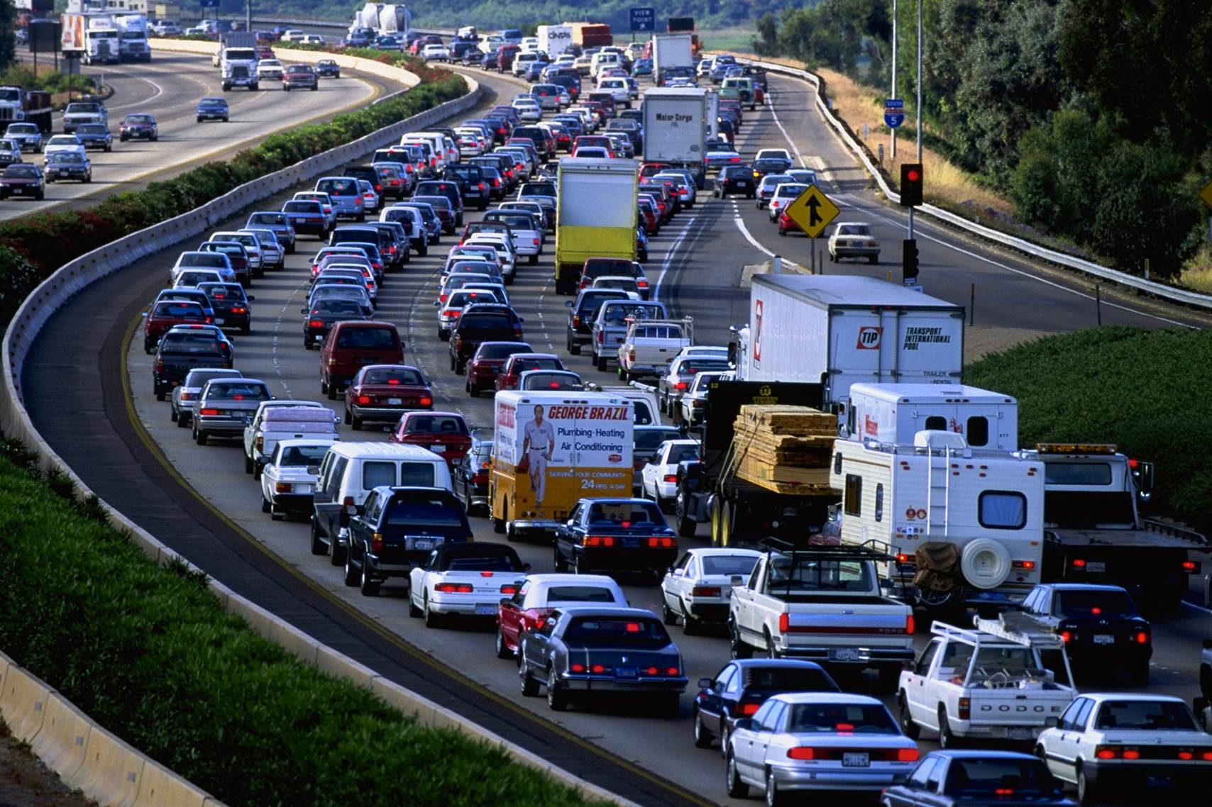

Slide 53
LOCALLY, LET’S INSIST THAT GROWTH SHOULD PAY AN INCREASED AND EQUITABLE SHARE

Slide 54
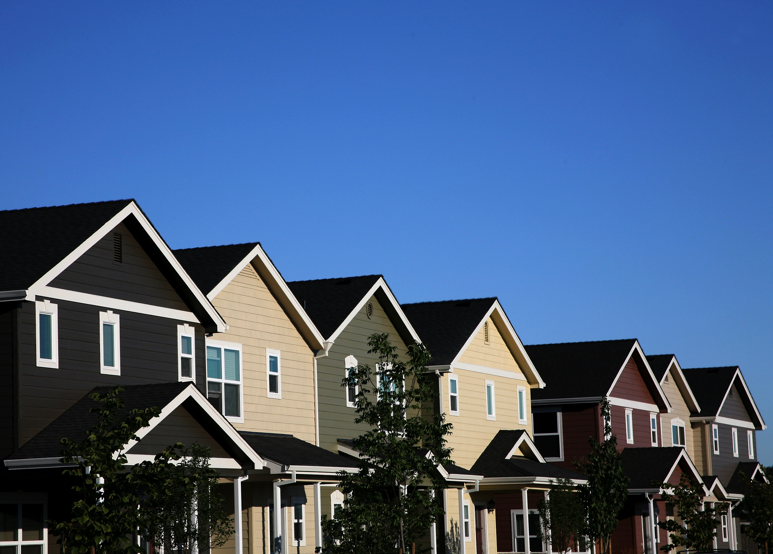

Slide 55
LET’S CONSIDER TOLLING WHERE IT MAKES SENSE

Slide 56
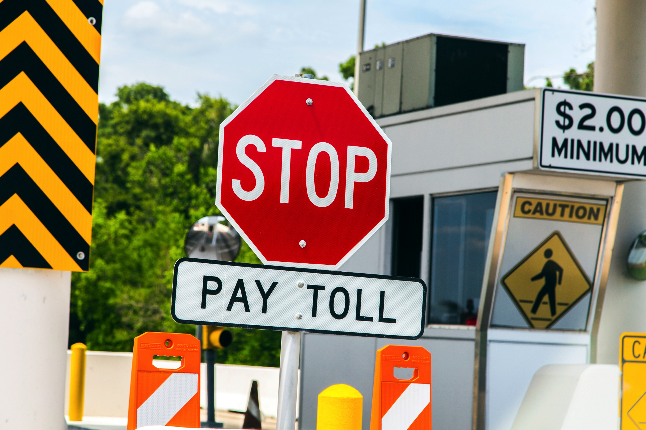

Slide 57
LET’S LEVERAGE FEDERAL AND STATE GRANTS

Slide 58


Slide 59
BUT WE STILL WON’T HAVE NEARLY ENOUGH TO PAY FOR OUR TRANSPORTATION PRIORITIES

Slide 60


Slide 61
WE NEED NEW REVENUE SOURCES

Slide 62


Slide 63
CIT IS NOT AVAILABLE UNTIL 2027

Slide 64
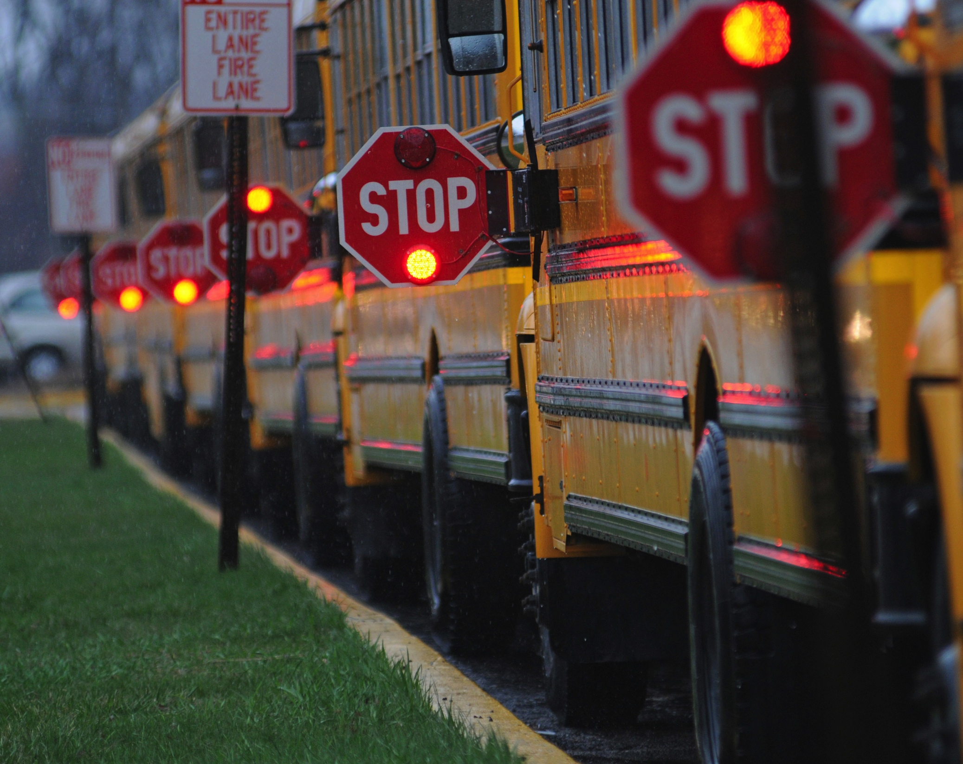

Slide 65
5 CENT GAS TAX COULD PAY FOR ALMOST 1 ½ MILE OF NEW ROAD EVERY YEAR

Slide 66
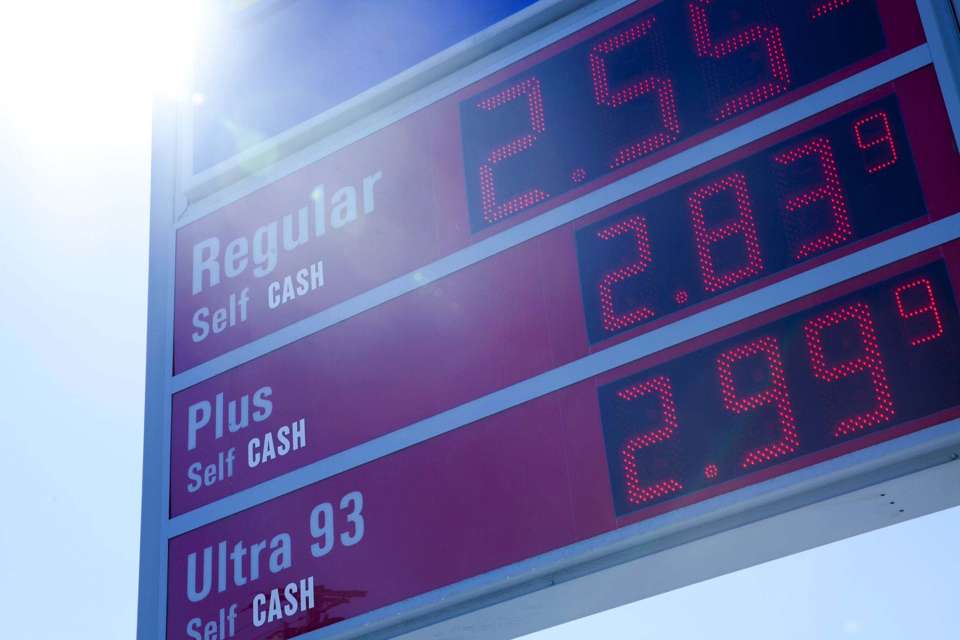

Slide 67
A TAX ON OUR PROPERTY COULD RAISE $68M ANNUALLY

Slide 68
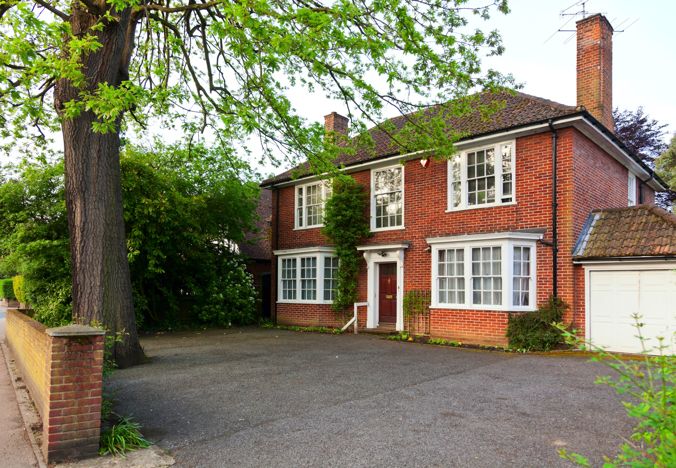

Slide 69
1% SALES TAX ON EVERYONE, INCLUDING VISITORS, RAISES $200M EVERY YEAR

Slide 70


Slide 71
WHAT DO YOU THINK?

Slide 72


Slide 73
HOW SHOULD WE PAY FOR THE TRANSPORTATION YOU WANT?

Slide 74


